Slide 1


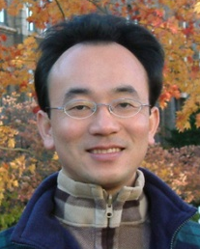
COVID-19後疫情時代
遠距行銷
(Social Distancing Marketing
Beyond COVID-19 Pandemic)
Min-Yuh Day
戴敏育
Associate Professor
副教授
Institute of Information Management, National Taipei University
國立臺北大學 資訊管理研究所
https://web.ntpu.edu.tw/~myday
2020-08-14

Slide 2



戴敏育 博士
(Min-Yuh Day, Ph.D.)
國立台北大學 資訊管理研究所 副教授
中央研究院 資訊科學研究所 訪問學人
國立台灣大學 資訊管理 博士
Publications Co-Chairs, IEEE/ACM International Conference on
Advances in Social Networks Analysis and Mining (ASONAM 2013- )
Program Co-Chair, IEEE International Workshop on
Empirical Methods for Recognizing Inference in TExt (IEEE EM-RITE 2012- )
Publications Chair, The IEEE International Conference on
Information Reuse and Integration (IEEE IRI)

Slide 3
Outline
Case Study on Marketing
Beyond COVID-19 Pandemic
Marketing Management
IT Enabled Digital Transformation
Business Model and
Marketing Strategy

Slide 4
Case Study on Marketing
Beyond COVID-19 Pandemic
Background Introduction
SWOT
  Strengths, Weaknesses, Opportunities, Threats
  PESTLE, Five Forces, Value Chain Analysis
  TOWS
STP
  Segmentation, Targeting, Positioning
4P
  Product, Price, Place, Promotion
Business Model

Slide 5
Marketing Management
1
Understanding Marketing Management
2
Capturing Marketing Insights
3
Connecting with Customers
4
Building Strong Brands
5
Creating Value
6
Delivering Value
7
Communicating Value
8
Conducting Marketing Responsibly for Long-term Success

Slide 6
Part 1. Understanding Marketing Management
1. Defining Marketing for the New Realities
2. Developing Marketing Strategies and Plans
1
Understanding Marketing Management

Slide 7
Part 2. Capturing Marketing Insights
3. Collecting Information and Forecasting Demand
4. Conducting Marketing Research
2
Capturing Marketing Insights

Slide 8
Part 3. Connecting with Customers
5. Creating Long-term Loyalty Relationships
6. Analyzing Consumer Markets
7. Analyzing Business Markets
8. Tapping into Global Markets
3
Connecting with Customers

Slide 9
Part 4. Building Strong Brands
9. Identifying Market Segments and Targets
10. Crafting the Brand Positioning
11. Creating Brand Equity
12. Addressing Competition and Driving Growth
4
Building Strong Brands

Slide 10
Part 5. Shaping the Market Offerings
13. Setting Product Strategy
14. Designing and Managing Services
15. Introducing New Market Offerings
16. Developing Pricing Strategies and Programs
5
Creating Value

Slide 11
Part 6. Delivering Value
17. Designing and Managing Integrated Marketing Channels
18. Managing Retailing, Wholesaling, and Logistics
6
Delivering Value

Slide 12
Part 7. Communicating Value
19. Designing and Managing Integrated Marketing Communications
20. Managing Mass Communications: Advertising, Sales Promotions, Events and Experiences, and Public Relations
21. Managing Digital Communications: Online, Social Media, and Mobile
22. Managing Personal Communications: Direct and Database Marketing and Personal Selling
7
Communicating Value

Slide 13
Part 8. Conducting Marketing Responsibly for Long-term Success
23. Managing a Holistic Marketing Organization for the Long Run
8
Conducting Marketing Responsibly for Long-term Success

Slide 14
IT Enabled
Digital Transformation

Slide 15
Marketing Management and
Information Systems

Slide 16
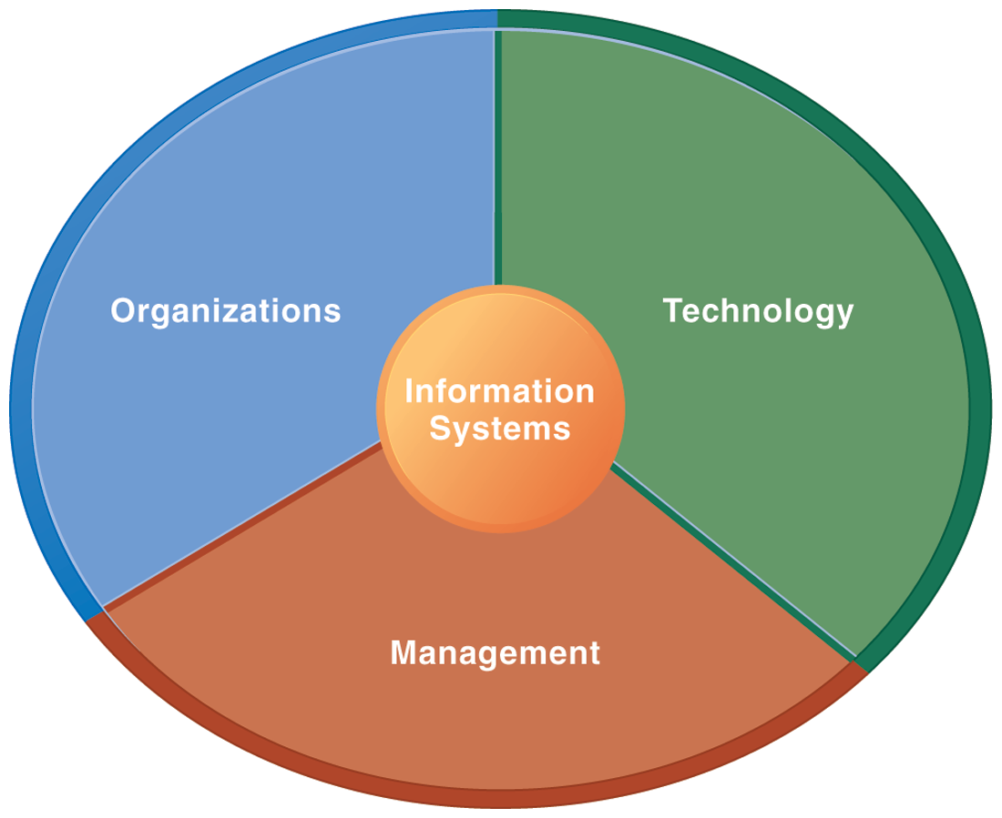
Information Management (MIS)
Information Systems

Slide 17
Fundamental MIS Concepts
Business
Challenges
Management
Organization
Information
System
Business
Solutions
Technology

Slide 18
Marketing

Slide 19
Marketing
“Meeting
needs profitably”

Slide 20
Marketing
“Marketing is an organizational function
and a set of processes for
creating, communicating, and delivering
value to customers and
for managing customer relationships
in ways that benefit the organization and its stakeholders.”

Slide 21
Marketing
Management

Slide 22
Marketing Management
“Marketing management is the
art and science
of choosing target markets
and getting, keeping, and growing
customers through
creating, delivering, and communicating
superior customer value.”

Slide 23
Marketing Management Tasks
Developing market strategies and plans
Capturing marketing insights
Connecting with customers
Building strong brands
Creating value
Delivering value
Communicating value
Creating successful long-term growth

Slide 24
The Essence of
Strategic Marketing (STP)
Segmentation
Targeting
Positioning

Slide 25
Customer
Value

Slide 26
Value
the sum of the
tangible and intangible
benefits and costs

Slide 27
Value
Total
customer
benefit
Customer perceived
value
Total
customer
cost

Slide 28
Customer Perceived Value
Product benefit
Total
customer
benefit
Customer perceived
value
Services benefit
Personnel benefit
Image benefit
Monetary cost
Total
customer
cost
Time cost
Energy cost
Psychological cost

Slide 29
Customer Value Triad
Quality, Service, and Price
(qsp)
Quality
Service
Price

Slide 30
Value and Satisfaction
Marketing
  identification, creation, communication, delivery, and monitoring of customer value.
Satisfaction
  a person’s judgment of a product’s
  perceived performance
  in relationship to
  expectations

Slide 31
Building
Customer Value,
Satisfaction, and
Loyalty

Slide 32
Satisfaction
“a person’s feelings of pleasure or disappointment that result from comparing a product’s
perceived performance (or outcome)
to expectations”

Slide 33
Loyalty
“a deeply held commitment to
rebuy or repatronize
a preferred product or service
in the future
despite situational influences and marketing efforts having the potential to cause switching behavior.”

Slide 34
Customer Perceived Value, Customer Satisfaction, and Loyalty
Customer Perceived Performance
Customer
Perceived Value
Customer
Satisfaction
Customer
Loyalty
Customer
Expectations

Slide 35
CEO CIO CFO
CEO
Strategy and Sales
(Leading)
CIO
Enterprise Technology Integration
CFO-COO
Finance and Operations
(Lagging)
Source: http://www.r3now.com/what-is-the-proper-relationship-for-the-cio-ceo-and-cfo/

Slide 36
CEO CIO CMO
CEO
Strategy and Sales
(Leading)
CIO
Enterprise Technology Integration
CMO
Marketing
Communication
Adapted from: http://www.r3now.com/what-is-the-proper-relationship-for-the-cio-ceo-and-cfo/

Slide 37
Business
Model and
Strategy

Slide 38
Business
Model

Slide 39
Business Model
8
7
2
4
1
Key
Partners
Key
Activities
Value Proposition
Customer
Relationships
Customer
Segments
6
3
Key
Resources
Channels
9
5
Cost
Structure
Revenue
Streams
Source: Alexander Osterwalder & Yves Pigneur, Business Model Generation: A Handbook for Visionaries, Game Changers, and Challengers, Wiley, 2010.

Slide 40
Definition of Business Model
A business model
describes the rationale of
how an organization
creates, delivers, and captures value.
Source: Alexander Osterwalder & Yves Pigneur, Business Model Generation: A Handbook for Visionaries, Game Changers, and Challengers, Wiley, 2010.

Slide 41
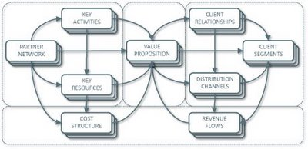
Business Model Canvas
Key
Activities
Customer Relationships
Key
Partners
Value
Preposition
Customer Segments
Key
Resources
Channels
Cost
Structure
Revenue
Streams
Source: http://nonlinearthinking.typepad.com/nonlinear_thinking/2008/07/the-business-model-canvas.html
https://www.youtube.com/watch?v=QoAOzMTLP5s

Slide 42
Business Model Canvas
Infrastructure Management
Product
Customer Interface
Key
Activities
Customer Relationships
Key
Partners
Value
Preposition
Customer Segments
Key
Resources
Channels
Financial Aspects
Cost
Structure
Revenue
Streams
Source: http://nonlinearthinking.typepad.com/nonlinear_thinking/2008/07/the-business-model-canvas.html
https://www.youtube.com/watch?v=QoAOzMTLP5s

Slide 43
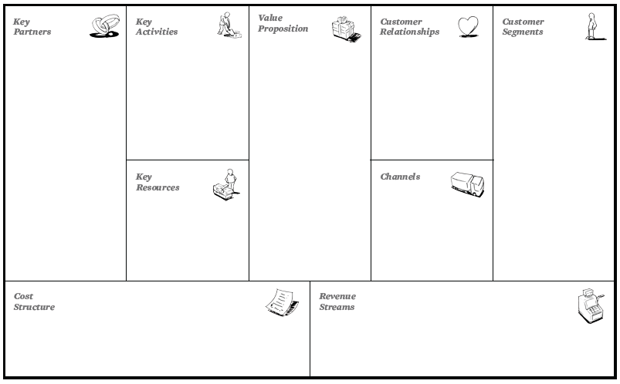
The 9 Building Blocks of
Business Model
8
7
2
4
1
6
3
9
5
Source: Alexander Osterwalder & Yves Pigneur, Business Model Generation: A Handbook for Visionaries, Game Changers, and Challengers, Wiley, 2010.

Slide 44
The 9 Building Blocks of
Business Model
8
7
2
4
1
How?
What?
Who?
6
3
Why?
9
5
Source: Alexander Osterwalder & Yves Pigneur, Business Model Generation: A Handbook for Visionaries, Game Changers, and Challengers, Wiley, 2010.

Slide 45
Marketing Strategy

Slide 46
Marketing Plan

Slide 47
Strategy vs.
Tactics

Slide 48
Strategy vs. Tactics
Policy
Strategic
Procedure
Tactical
Execution
Operational
Source: http://joyante.wordpress.com/2011/02/21/business-strategy-versus-tactics/

Slide 49
Strategy vs. Tactics
Strategy
Tactics
Planning
Doing
Large Scale
Smaller Scale
Why
How
Difficult to Copy
Easy to Copy
Long Time Frame
Short Time Frame

Slide 50
Strategy
Plans
Tactics

Slide 51
Strategy > Plans > Tactics
Strategy involves a blueprint for gaining a competitive advantage.
Plans are the second-level goals in the hierarchy.
  A complex strategy may contain many plans.
Tactics are the step-by-step methods you use to accomplish a plan.

Slide 52
Marketing Planning Process
Analyzing marketing opportunities
Selecting target markets
Designing marketing strategies
Developing marketing programs
Managing the marketing effort

Slide 53
The Strategic Planning,
Implementation, and Control Processes
Planning
Implementing
Controlling
Corporate
Planning
Organizing
Measuring Results
Division
Planning
Diagnosing Results
Implementing
Business Planning
Taking corrective
action
Product
Planning

Slide 54
Marketing Plan
The strategic marketing plan
lays out the target markets and
the firm’s value proposition,
based on an analysis of the best market opportunities.

Slide 55
Marketing Plan
The tactical marketing plan specifies the marketing tactics, including product features, promotion, merchandising, pricing, sales channels, and service.

Slide 56
Business Unit Strategic-Planning Process
External environment (Opportunity & Threat analysis)
Business Mission
Goal
formulation
Strategy
formulation
Program formulation
Implementation
Feedback
and
Control
SWOT analysis
Internal environment (Strengths & weakness analysis)

Slide 57
Business Unit Strategic-Planning Process
External environment (Opportunity & Threat analysis)
Business Mission
Goal
formulation
Strategy
formulation
Program formulation
Implementation
Feedback
and
Control
SWOT analysis
Internal environment (Strengths & weakness analysis)
1
Business Mission

Slide 58
Business Unit Strategic-Planning Process
External environment (Opportunity & Threat analysis)
Business Mission
Goal
formulation
Strategy
formulation
Program formulation
Implementation
Feedback
and
Control
SWOT analysis
Internal environment (Strengths & weakness analysis)
2
External environment
(Opportunity & Threat analysis)
SWOT analysis
Internal environment
(Strengths & weakness analysis)

Slide 59
Business Unit Strategic-Planning Process
External environment (Opportunity & Threat analysis)
Business Mission
Goal
formulation
Strategy
formulation
Program formulation
Implementation
Feedback
and
Control
SWOT analysis
Internal environment (Strengths & weakness analysis)
3
Goal
formulation

Slide 60
Business Unit Strategic-Planning Process
External environment (Opportunity & Threat analysis)
Business Mission
Goal
formulation
Strategy
formulation
Program formulation
Implementation
Feedback
and
Control
SWOT analysis
Internal environment (Strengths & weakness analysis)
4
Strategy
formulation

Slide 61
Business Unit Strategic-Planning Process
External environment (Opportunity & Threat analysis)
Business Mission
Goal
formulation
Strategy
formulation
Program formulation
Implementation
Feedback
and
Control
SWOT analysis
Internal environment (Strengths & weakness analysis)
5
Program formulation

Slide 62
Business Unit Strategic-Planning Process
External environment (Opportunity & Threat analysis)
Business Mission
Goal
formulation
Strategy
formulation
Program formulation
Implementation
Feedback
and
Control
SWOT analysis
Internal environment (Strengths & weakness analysis)
6
Implementation

Slide 63
Business Unit Strategic-Planning Process
External environment (Opportunity & Threat analysis)
Business Mission
Goal
formulation
Strategy
formulation
Program formulation
Implementation
Feedback
and
Control
SWOT analysis
Internal environment (Strengths & weakness analysis)
7
Feedback
and
Control

Slide 64
Marketing Plan Contents
Executive summary (1.0)
Table of contents
Situation analysis (2.0) (Ch1)
Marketing strategy (3.0) (Ch2)
Marketing tactics (4.0) (Ch3)
Financial projections (5.0) (Ch4)
Implementation controls (6.0) (Ch5)

Slide 65
Sample Marketing Plan
1.0
Executive Summary
1.0 Executive Summary
2.0 Situation Analysis
3.0 Marketing Strategy
4.0 Marketing Tactics
5.0 Financials
6.0 Controls
2.0
Situation Analysis
3.0
Marketing Strategy
4.0
Marketing Tactics
5.0
Financials
6.0
Controls

Slide 66
2.0 Situation Analysis
Sample Marketing Plan
1.0
Executive Summary
2.1 Market Summary
2.2 SWOT Analysis
2.3 Competition
2.4 Product Offering
2.5 Keys to Success
2.6 Critical Issues
2.0
Situation Analysis
3.0
Marketing Strategy
4.0
Marketing Tactics
5.0
Financials
6.0
Controls

Slide 67
2.1 Market Summary
Sample Marketing Plan
1.0
Executive Summary
2.1.1 Market Demographics
  Geographics
  Demographics
  Behavior Factors
2.1.2 Market Needs
2.1.3 Market Trends
2.1.4 Market Growth
2.0
Situation Analysis
3.0
Marketing Strategy
4.0
Marketing Tactics
5.0
Financials
6.0
Controls

Slide 68
3.0 Marketing Strategy
Sample Marketing Plan
1.0
Executive Summary
3.1 Mission
3.2 Marketing Objectives
3.3 Financial Objectives
3.4 Target Markets
3.5 Positioning
2.0
Situation Analysis
3.0
Marketing Strategy
4.0
Marketing Tactics
5.0
Financials
6.0
Controls

Slide 69
4.0 Marketing Tactics
Sample Marketing Plan
1.0
Executive Summary
4.1 Product
4.2 Pricing
4.3 Distribution (Place)
4.4 Communications (Promotion)
4.5 Marketing Research
2.0
Situation Analysis
3.0
Marketing Strategy
4.0
Marketing Tactics
5.0
Financials
6.0
Controls

Slide 70
5.0 Financials
Sample Marketing Plan
1.0
Executive Summary
5.1 Break-Even Analysis
5.2 Sales Forecast
5.3 Expense Forecast
2.0
Situation Analysis
3.0
Marketing Strategy
4.0
Marketing Tactics
5.0
Financials
6.0
Controls

Slide 71
6.0 Controls
Sample Marketing Plan
1.0
Executive Summary
6.1 Implementation
6.2 Marketing Organization
6.3 Contingency Planning
2.0
Situation Analysis
3.0
Marketing Strategy
4.0
Marketing Tactics
5.0
Financials
6.0
Controls

Slide 72
Evaluating a Marketing Plan
Is the plan simple/succinct?
Is the plan complete?
Is the plan specific?
Is the plan realistic?

Slide 73
Summary
Case Study on Marketing
Beyond COVID-19 Pandemic
Marketing Management
IT Enabled Digital Transformation
Business Model and
Marketing Strategy

Slide 74
Q & A
COVID-19後疫情時代
遠距行銷
(Social Distancing Marketing
Beyond COVID-19 Pandemic)
Min-Yuh Day
戴敏育
Associate Professor
副教授
Institute of Information Management, National Taipei University
國立臺北大學 資訊管理研究所
https://web.ntpu.edu.tw/~myday
2020-08-14

