Slide 1


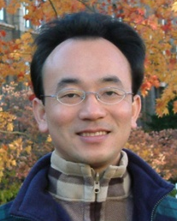
深度學習和通用句子嵌入模型 (Deep Learning and
Universal Sentence-Embedding Models)
Min-Yuh Day
戴敏育
Associate Professor
副教授
Institute of Information Management, National Taipei University
國立臺北大學 資訊管理研究所
https://web.ntpu.edu.tw/~myday
2020-08-14

Slide 2
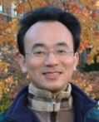


戴敏育 博士
(Min-Yuh Day, Ph.D.)
國立台北大學 資訊管理研究所 副教授
中央研究院 資訊科學研究所 訪問學人
國立台灣大學 資訊管理 博士
Publications Co-Chairs, IEEE/ACM International Conference on
Advances in Social Networks Analysis and Mining (ASONAM 2013- )
Program Co-Chair, IEEE International Workshop on
Empirical Methods for Recognizing Inference in TExt (IEEE EM-RITE 2012- )
Publications Chair, The IEEE International Conference on
Information Reuse and Integration (IEEE IRI)

Slide 3
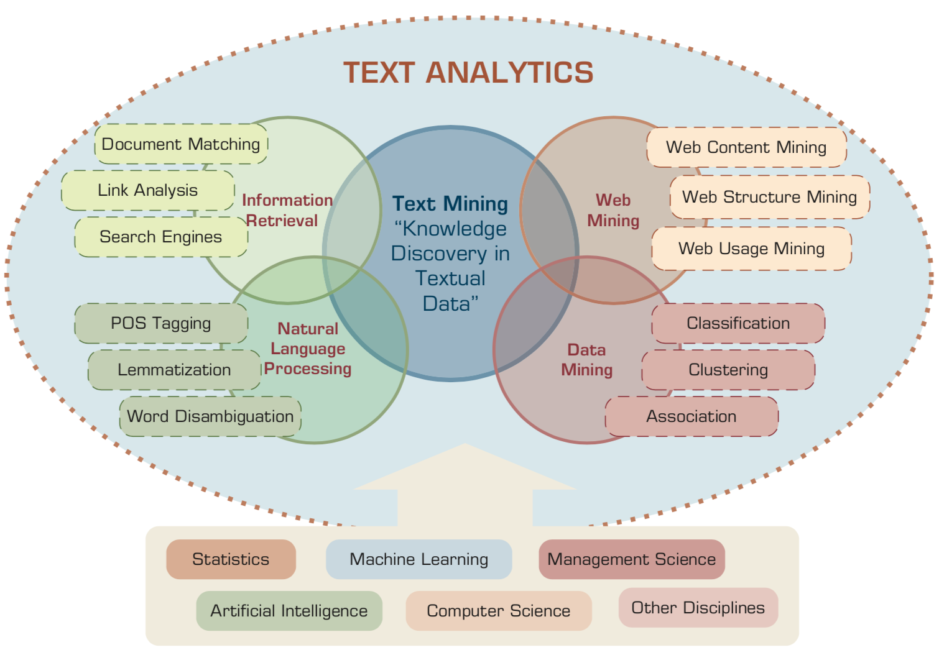
AI for Text Analytics
Source: Ramesh Sharda, Dursun Delen, and Efraim Turban (2017), Business Intelligence, Analytics, and Data Science: A Managerial Perspective, 4th Edition, Pearson

Slide 4
Topics
自然語言處理核心技術與文字探勘
(Core Technologies of Natural Language Processing and Text Mining)
人工智慧文本分析基礎與應用
(Artificial Intelligence for Text Analytics: Foundations and Applications)
文本表達特徵工程
(Feature Engineering for Text Representation)
語意分析和命名實體識別
(Semantic Analysis and Named Entity Recognition; NER)
深度學習和通用句子嵌入模型
(Deep Learning and Universal Sentence-Embedding Models)
問答系統與對話系統
(Question Answering and Dialogue Systems)

Slide 5
Deep Learning and
Universal
Sentence-Embedding Models

Slide 6
Outline
Universal Sentence Encoder (USE)
Universal Sentence Encoder Multilingual (USEM)
Semantic Similarity

Slide 7
NLP
Source: http://blog.aylien.com/leveraging-deep-learning-for-multilingual/

Slide 8
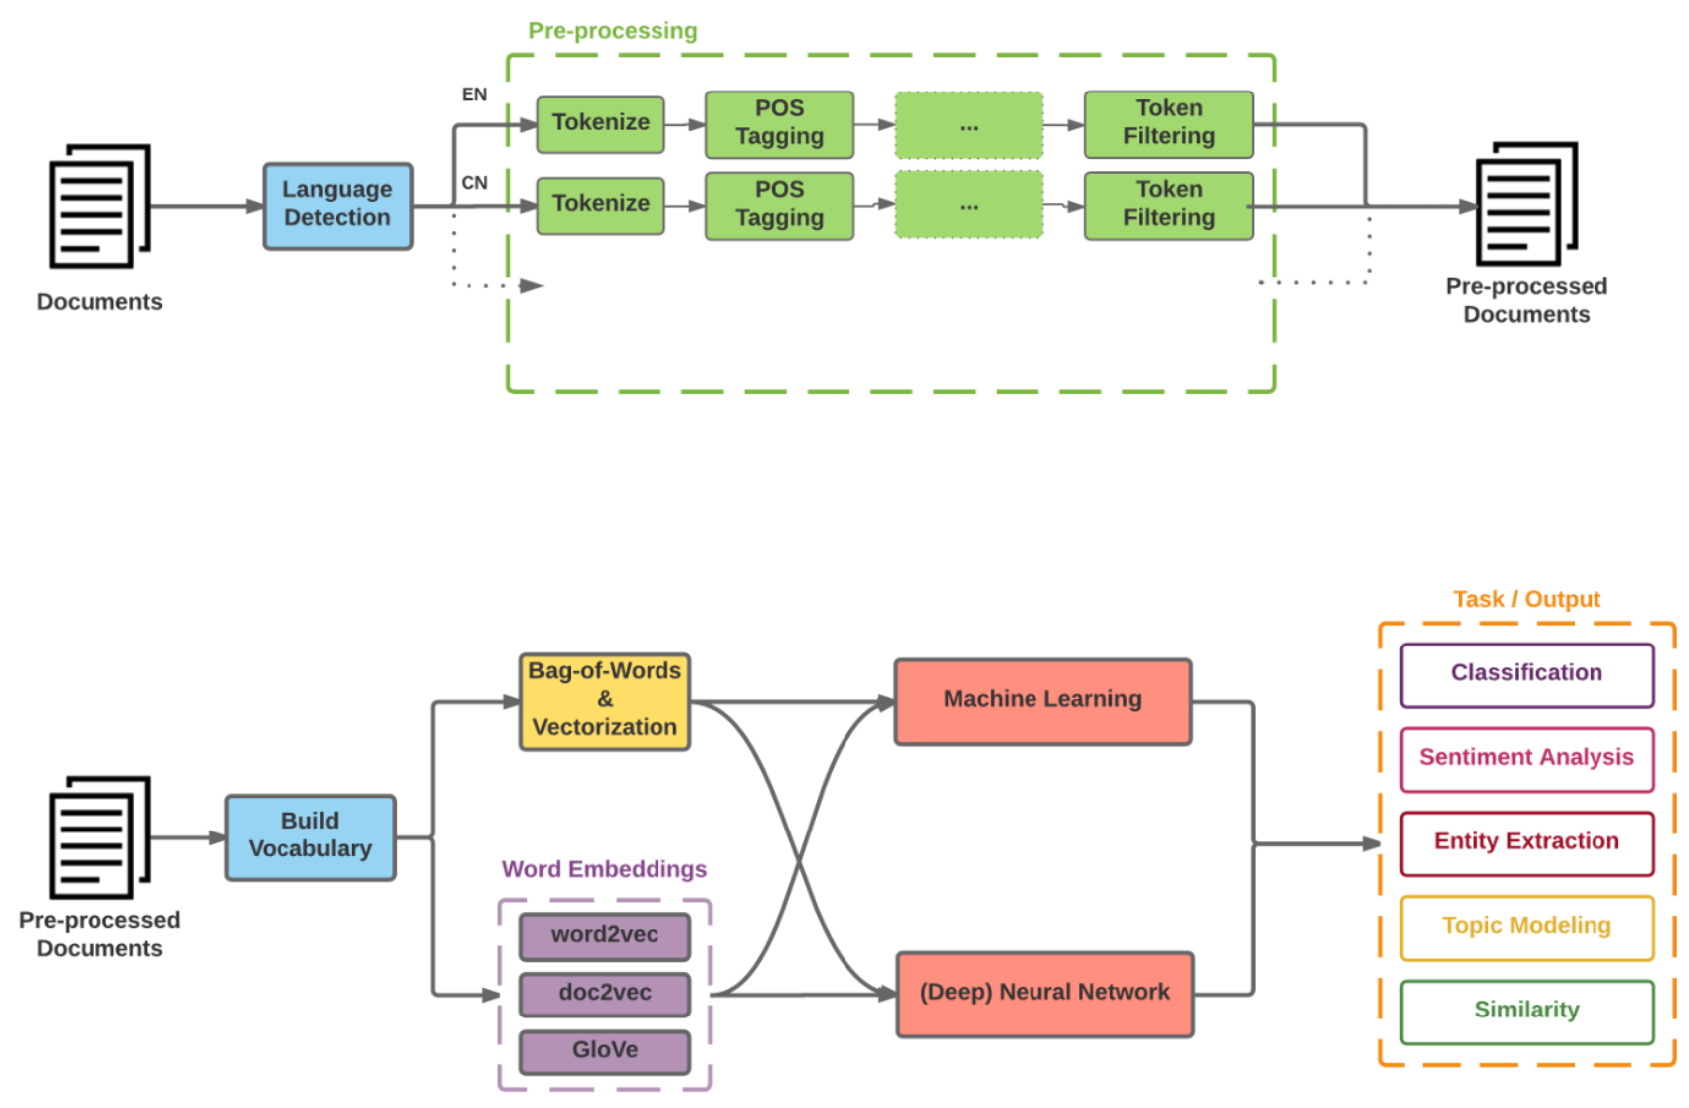
Modern NLP Pipeline
Source: https://github.com/fortiema/talks/blob/master/opendata2016sh/pragmatic-nlp-opendata2016sh.pdf

Slide 9
Modern NLP Pipeline
Source: http://mattfortier.me/2017/01/31/nlp-intro-pt-1-overview/

Slide 10
Deep Learning NLP
Source: http://mattfortier.me/2017/01/31/nlp-intro-pt-1-overview/

Slide 11
Natural Language Processing (NLP) and Text Mining
Raw text
Sentence Segmentation
Tokenization
Part-of-Speech (POS)
Stop word removal
word’s stem
am → am
having → hav
word’s lemma
am → be
having → have
Stemming / Lemmatization
Dependency Parser
String Metrics & Matching
Source: Nitin Hardeniya (2015), NLTK Essentials, Packt Publishing; Florian Leitner (2015), Text mining - from Bayes rule to dependency parsing

Slide 12


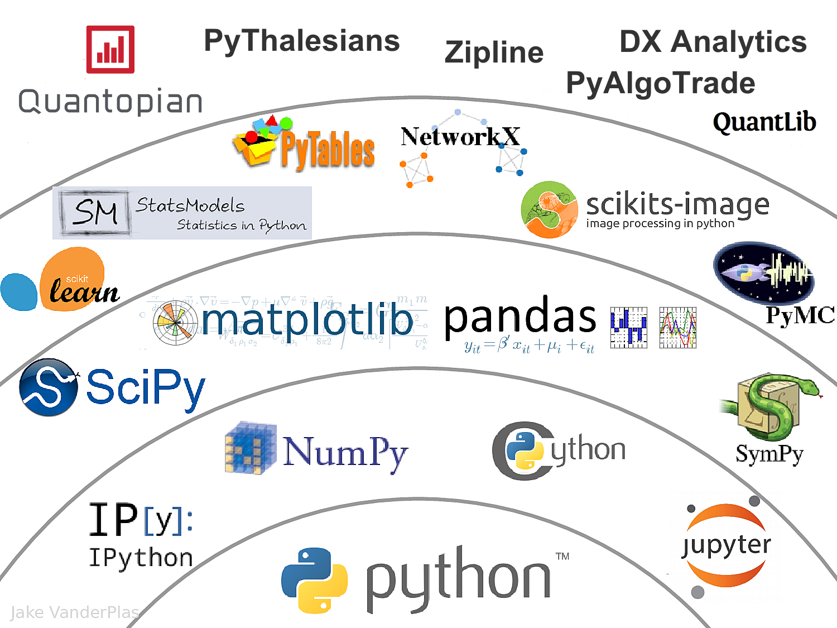



Data Science Python Stack
Source: http://nbviewer.jupyter.org/format/slides/github/quantopian/pyfolio/blob/master/pyfolio/examples/overview_slides.ipynb#/5

Slide 13
Universal Sentence Encoder (USE)
The Universal Sentence Encoder
encodes text into high-dimensional vectors that can be used for
text classification,
semantic similarity,
clustering and
other natural language tasks.
The universal-sentence-encoder model is trained with a deep averaging network (DAN) encoder.
Source: https://tfhub.dev/google/universal-sentence-encoder/4

Slide 14
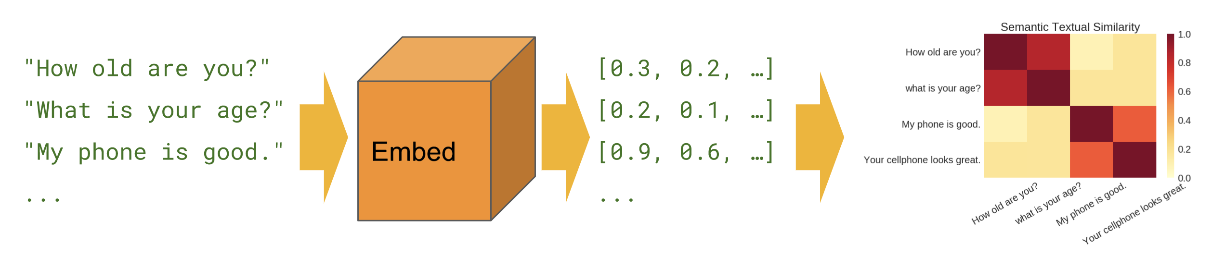
Universal Sentence Encoder (USE)
Semantic Similarity
Source: https://tfhub.dev/google/universal-sentence-encoder/4

Slide 15
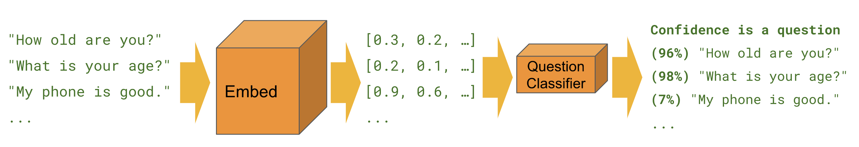
Universal Sentence Encoder (USE)
Classification
Source: https://tfhub.dev/google/universal-sentence-encoder/4

Slide 16
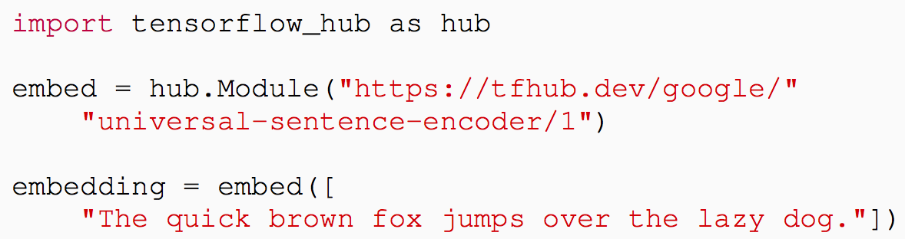
Universal Sentence Encoder (USE)
Source: Daniel Cer, Yinfei Yang, Sheng-yi Kong, Nan Hua, Nicole Limtiaco, Rhomni St. John, Noah Constant, Mario Guajardo-Céspedes, Steve Yuan, Chris Tar, Yun-Hsuan Sung, Brian Strope, Ray Kurzweil. Universal Sentence Encoder. arXiv:1803.11175, 2018.

Slide 17
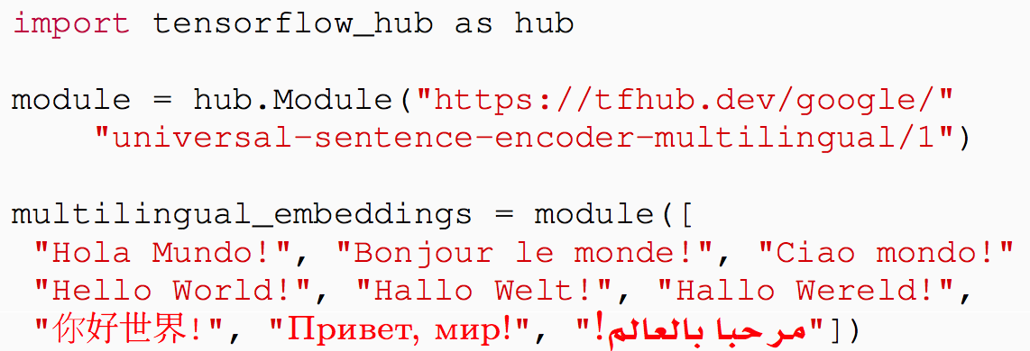
Multilingual
Universal Sentence Encoder (MUSE)
Source: Yinfei Yang, Daniel Cer, Amin Ahmad, Mandy Guo, Jax Law, Noah Constant, Gustavo Hernandez Abrego , Steve Yuan, Chris Tar, Yun-hsuan Sung, Ray Kurzweil. Multilingual Universal Sentence Encoder for Semantic Retrieval. July 2019

Slide 18
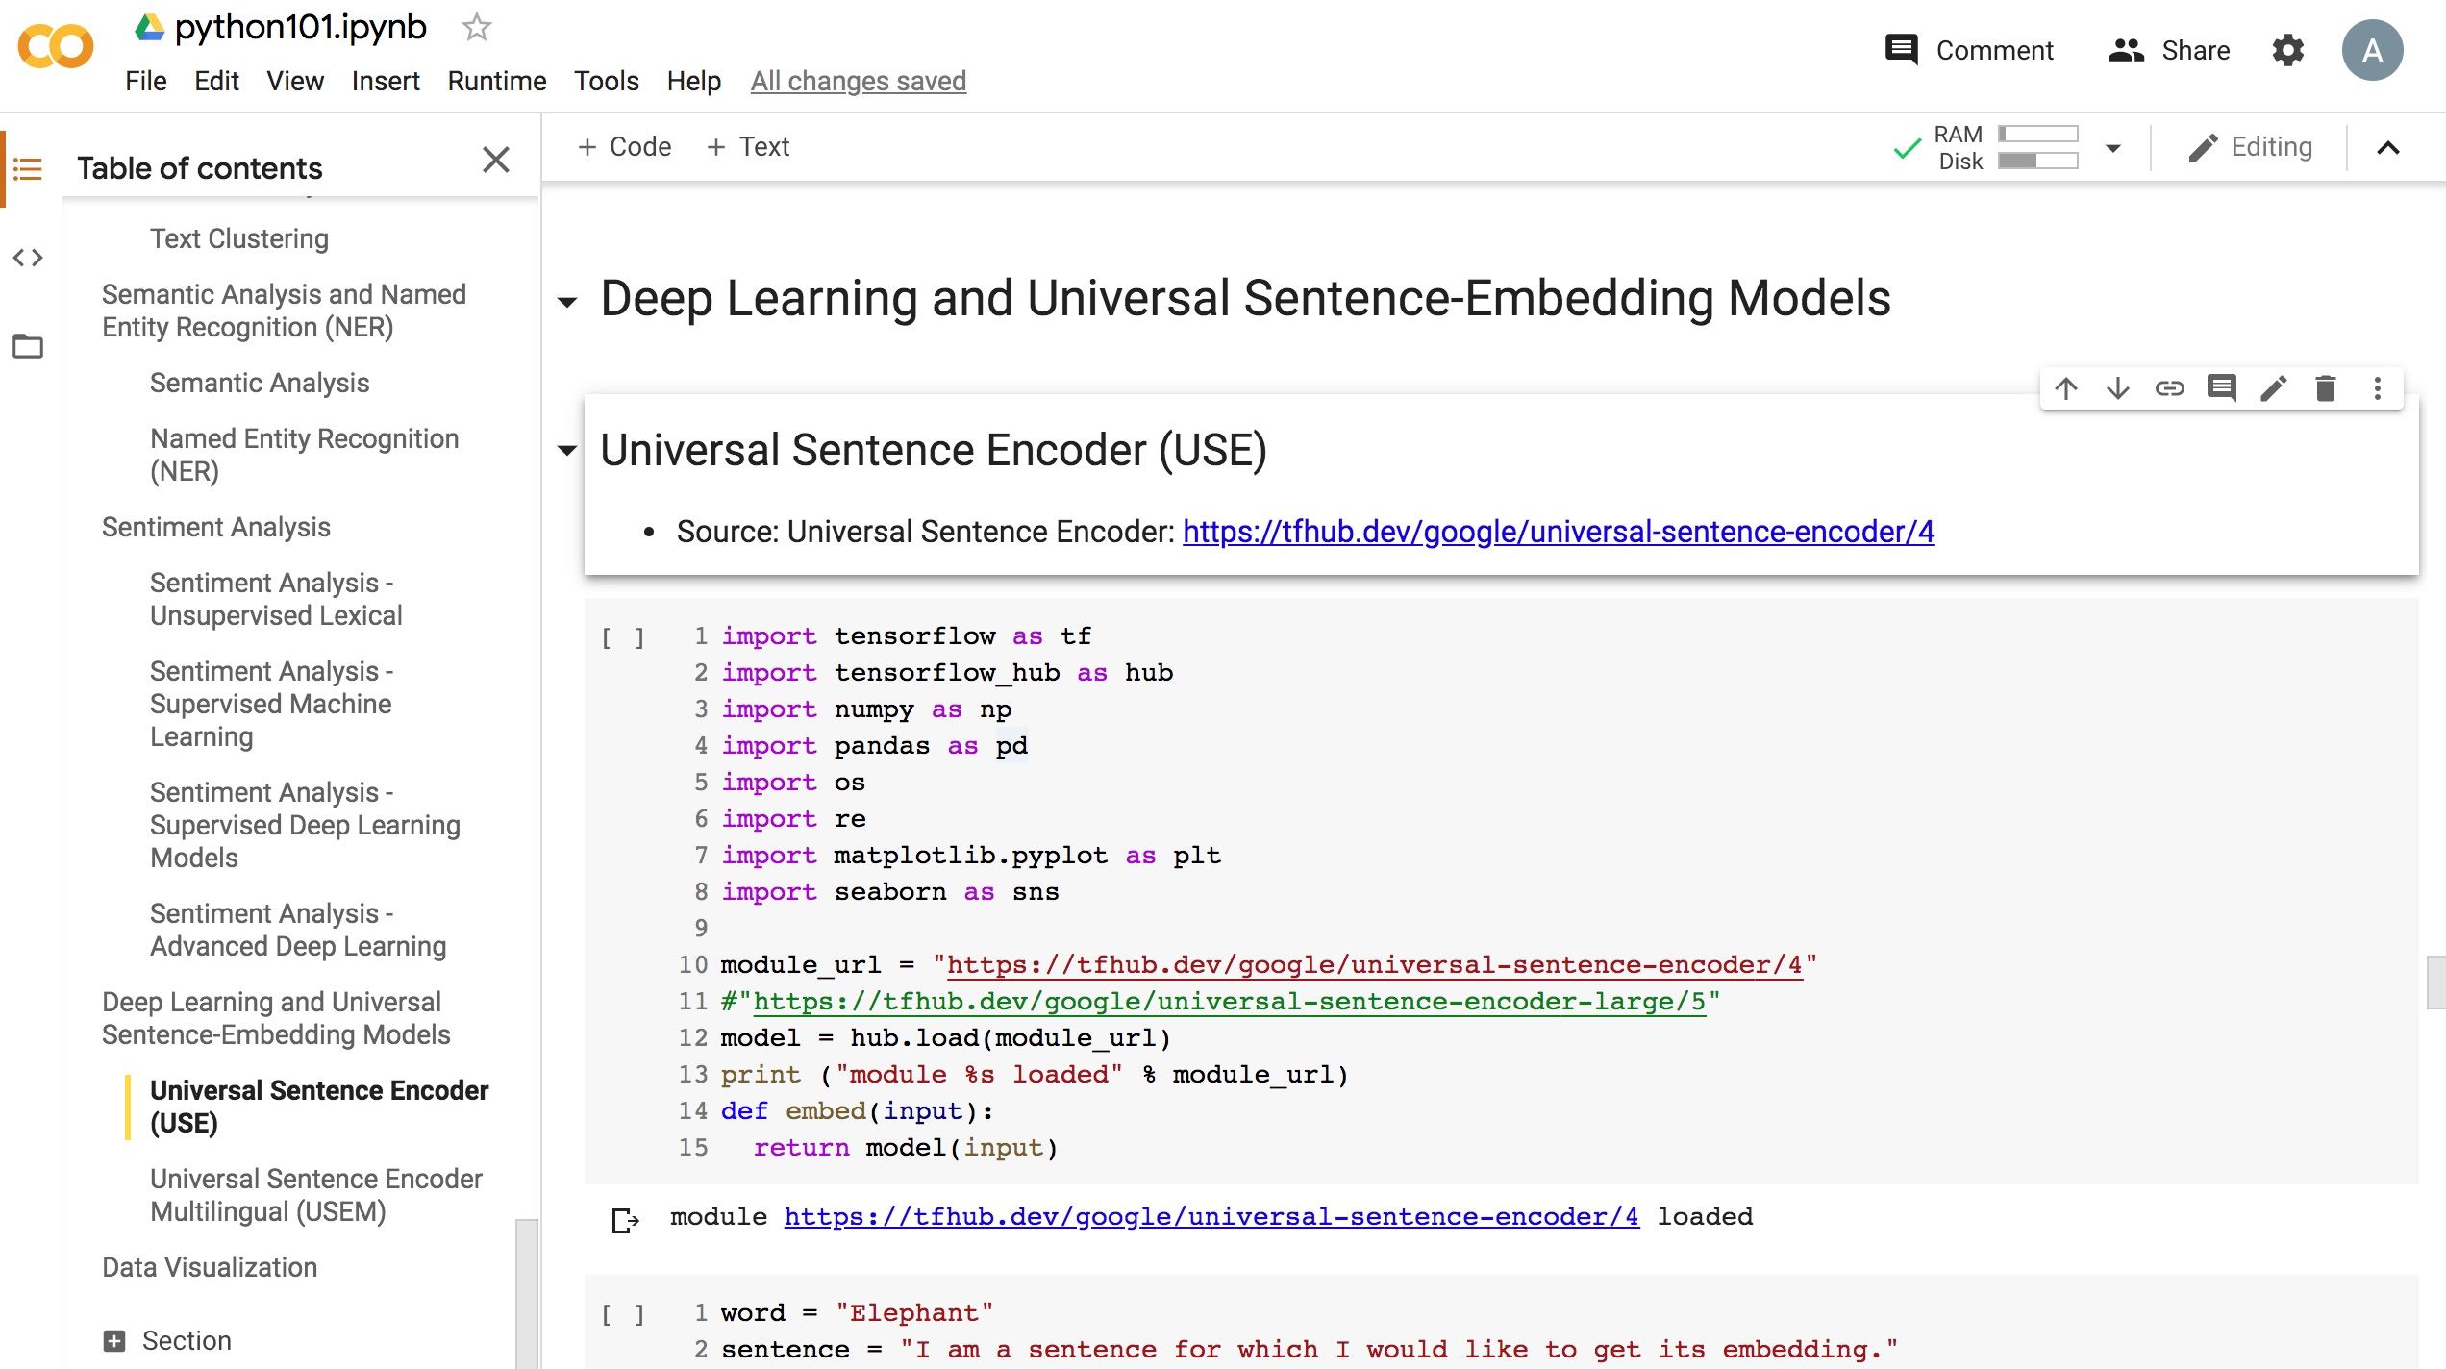
Python in Google Colab (Python101)
https://colab.research.google.com/drive/1FEG6DnGvwfUbeo4zJ1zTunjMqf2RkCrT
https://tinyurl.com/aintpupython101

Slide 19
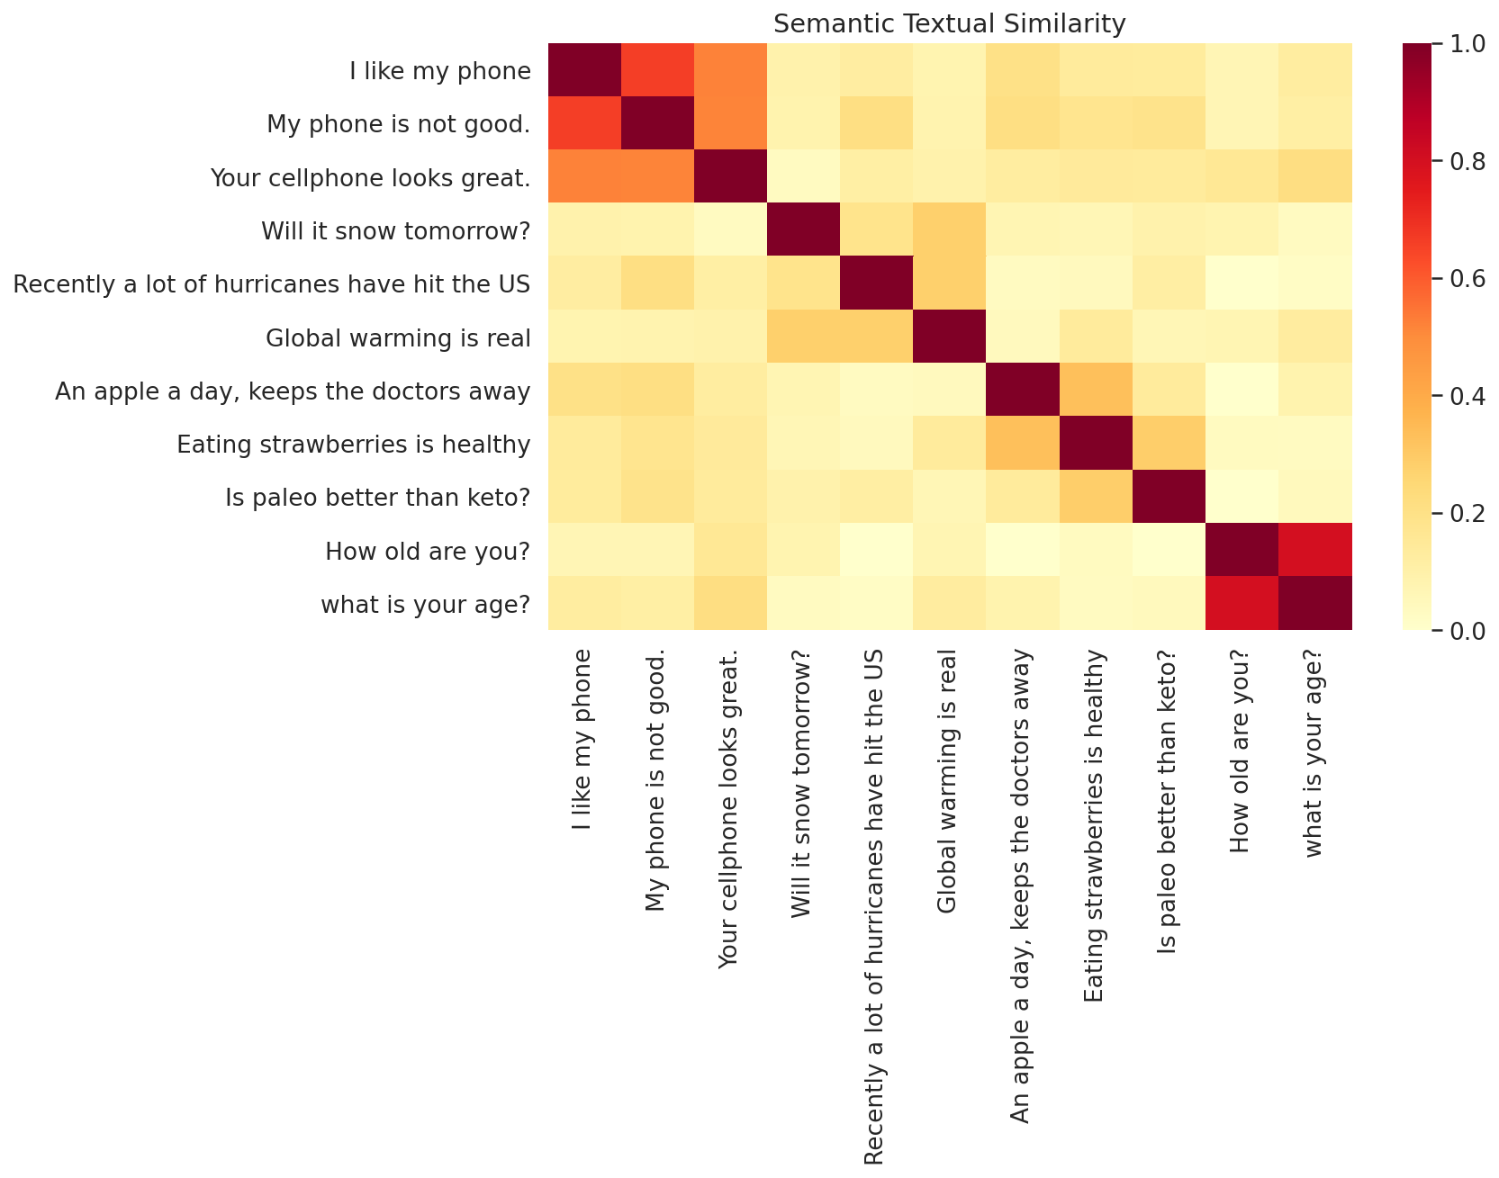
Python in Google Colab (Python101)
https://colab.research.google.com/drive/1FEG6DnGvwfUbeo4zJ1zTunjMqf2RkCrT
https://tinyurl.com/aintpupython101

Slide 20
One-hot encoding
'The mouse ran up the clock’ =
[ [0, 1, 0, 0, 0, 0, 0],
[0, 0, 1, 0, 0, 0, 0],
[0, 0, 0, 1, 0, 0, 0],
[0, 0, 0, 0, 1, 0, 0],
[0, 1, 0, 0, 0, 0, 0],
[0, 0, 0, 0, 0, 1, 0] ]
The
mouse
ran
up
the
clock
1
2
3
4
1
5
[0, 1, 2, 3, 4, 5, 6]
Source: https://developers.google.com/machine-learning/guides/text-classification/step-3

Slide 21
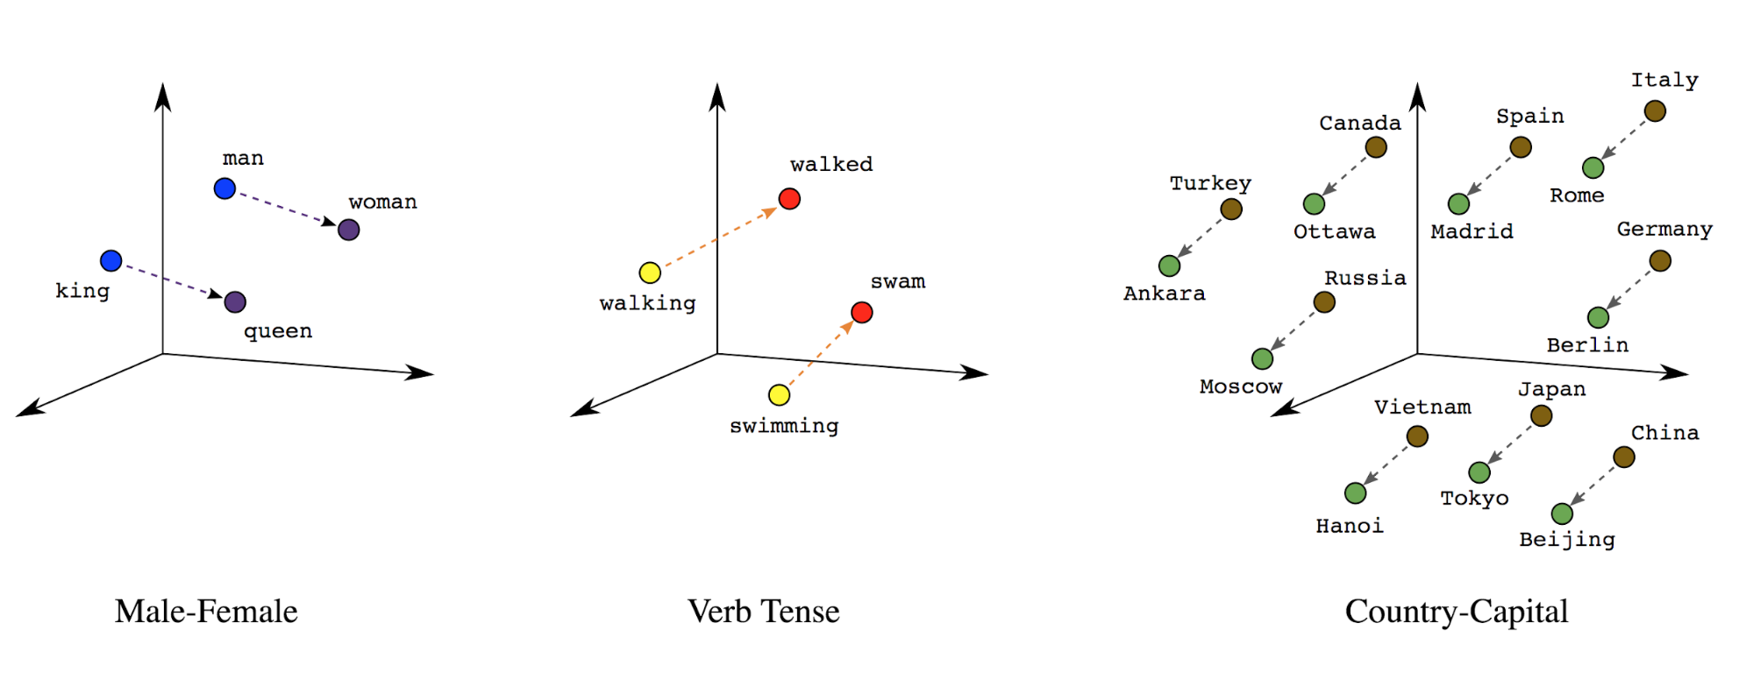
Word embeddings
Source: https://developers.google.com/machine-learning/guides/text-classification/step-3

Slide 22
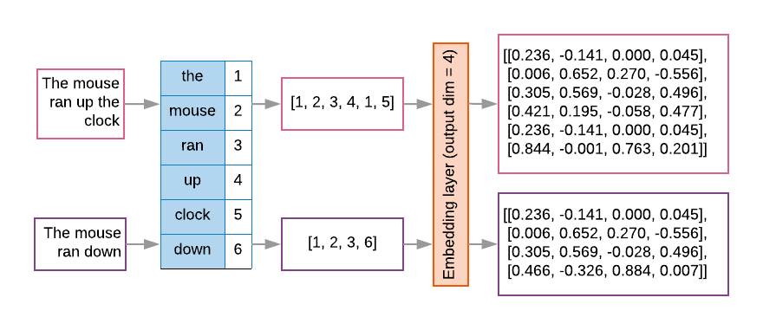
Word embeddings
Source: https://developers.google.com/machine-learning/guides/text-classification/step-3

Slide 23
Sequence to Sequence
(Seq2Seq)
Source: https://google.github.io/seq2seq/

Slide 24
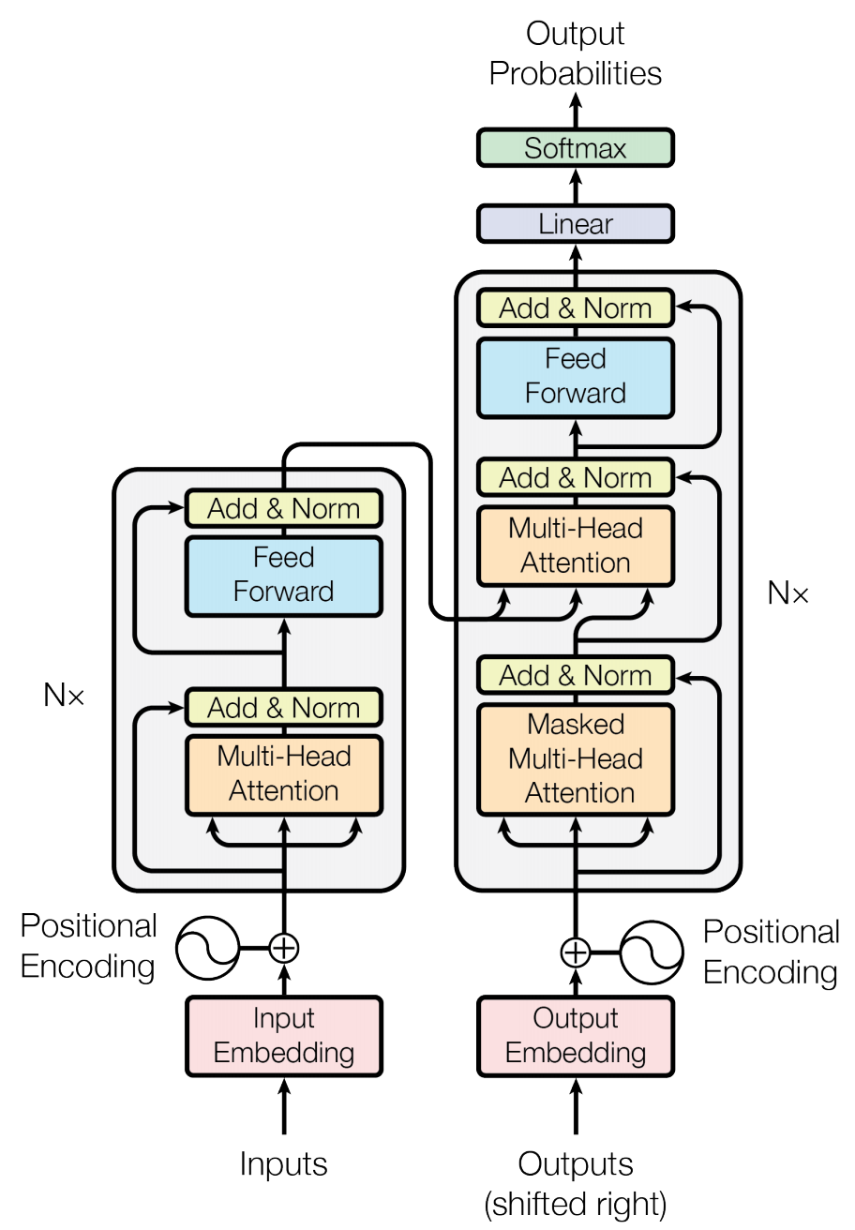
Transformer (Attention is All You Need)
(Vaswani et al., 2017)
Source: Vaswani, Ashish, Noam Shazeer, Niki Parmar, Jakob Uszkoreit, Llion Jones, Aidan N. Gomez, Łukasz Kaiser, and Illia Polosukhin. "Attention is all you need." In Advances in neural information processing systems, pp. 5998-6008. 2017.

Slide 25
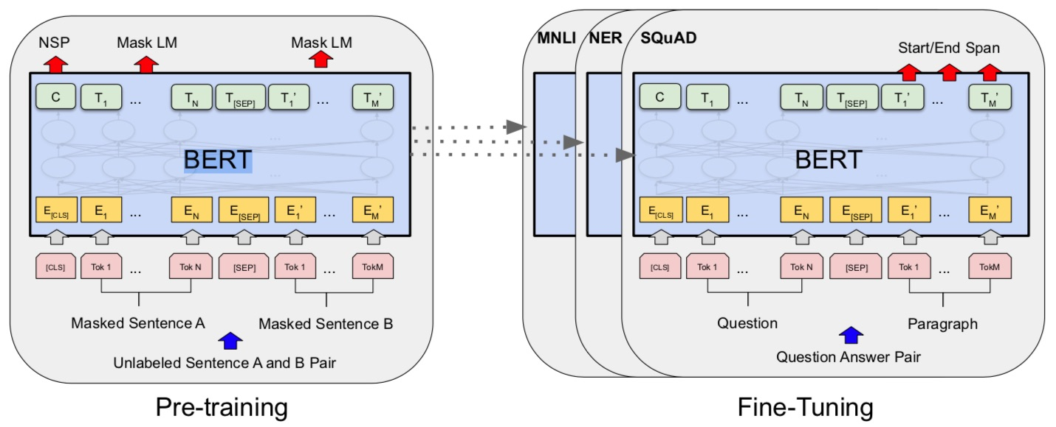
BERT: Pre-training of Deep Bidirectional Transformers for Language Understanding
BERT (Bidirectional Encoder Representations from Transformers)
Overall pre-training and fine-tuning procedures for BERT
Source: Devlin, Jacob, Ming-Wei Chang, Kenton Lee, and Kristina Toutanova (2018).
"Bert: Pre-training of deep bidirectional transformers for language understanding." arXiv preprint arXiv:1810.04805.

Slide 26
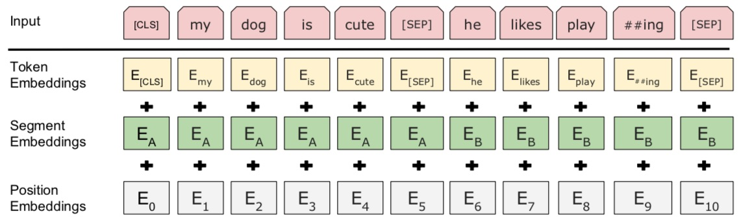
BERT: Pre-training of Deep Bidirectional Transformers for Language Understanding
BERT (Bidirectional Encoder Representations from Transformers)
BERT input representation
Source: Devlin, Jacob, Ming-Wei Chang, Kenton Lee, and Kristina Toutanova (2018).
"Bert: Pre-training of deep bidirectional transformers for language understanding." arXiv preprint arXiv:1810.04805.

Slide 27
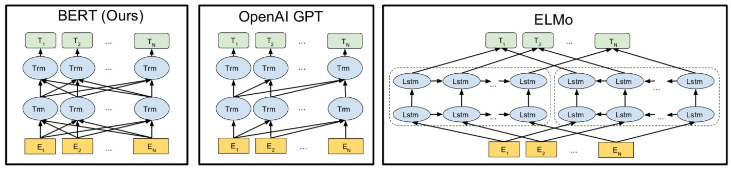
BERT, OpenAI GPT, ELMo
Source: Devlin, Jacob, Ming-Wei Chang, Kenton Lee, and Kristina Toutanova (2018).
"Bert: Pre-training of deep bidirectional transformers for language understanding." arXiv preprint arXiv:1810.04805.

Slide 28
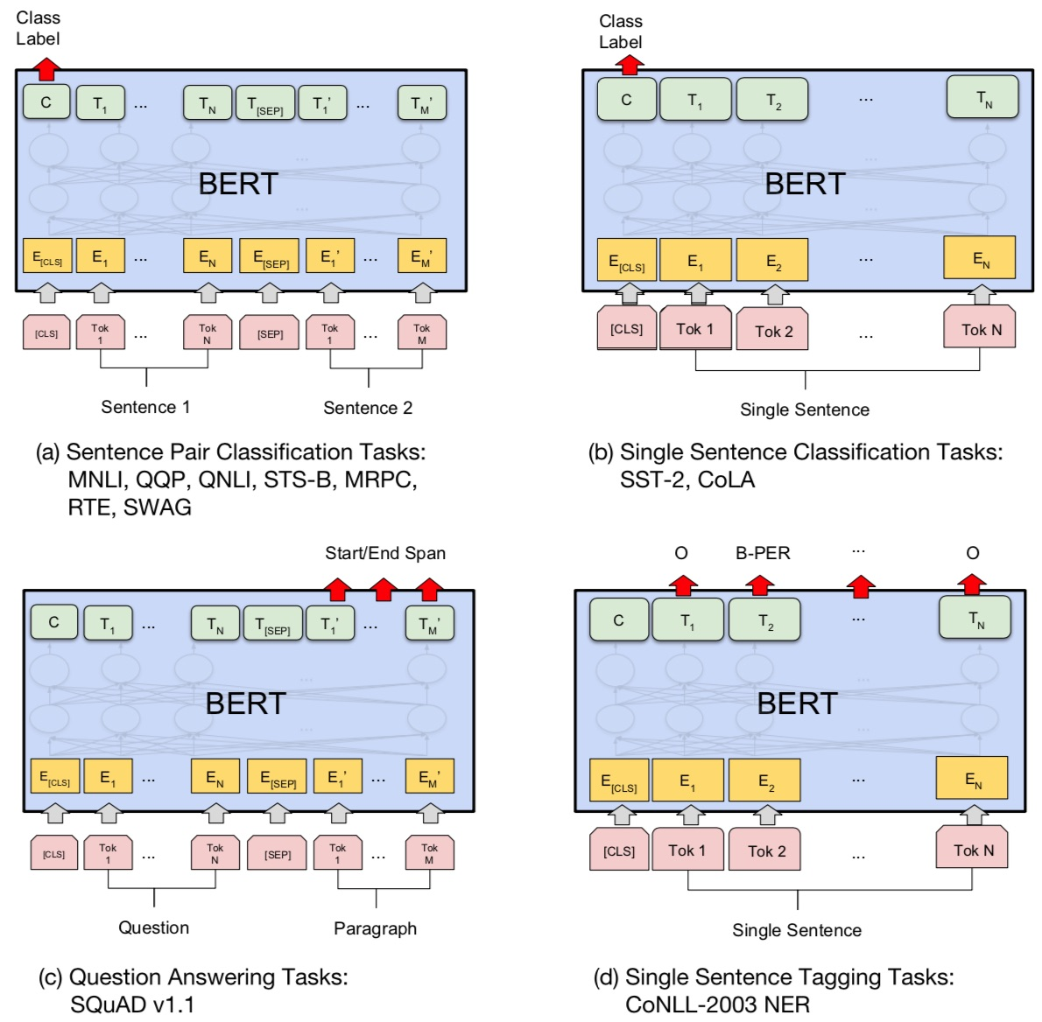
Fine-tuning BERT on Different Tasks
Source: Devlin, Jacob, Ming-Wei Chang, Kenton Lee, and Kristina Toutanova (2018).
"Bert: Pre-training of deep bidirectional transformers for language understanding." arXiv preprint arXiv:1810.04805.

Slide 29
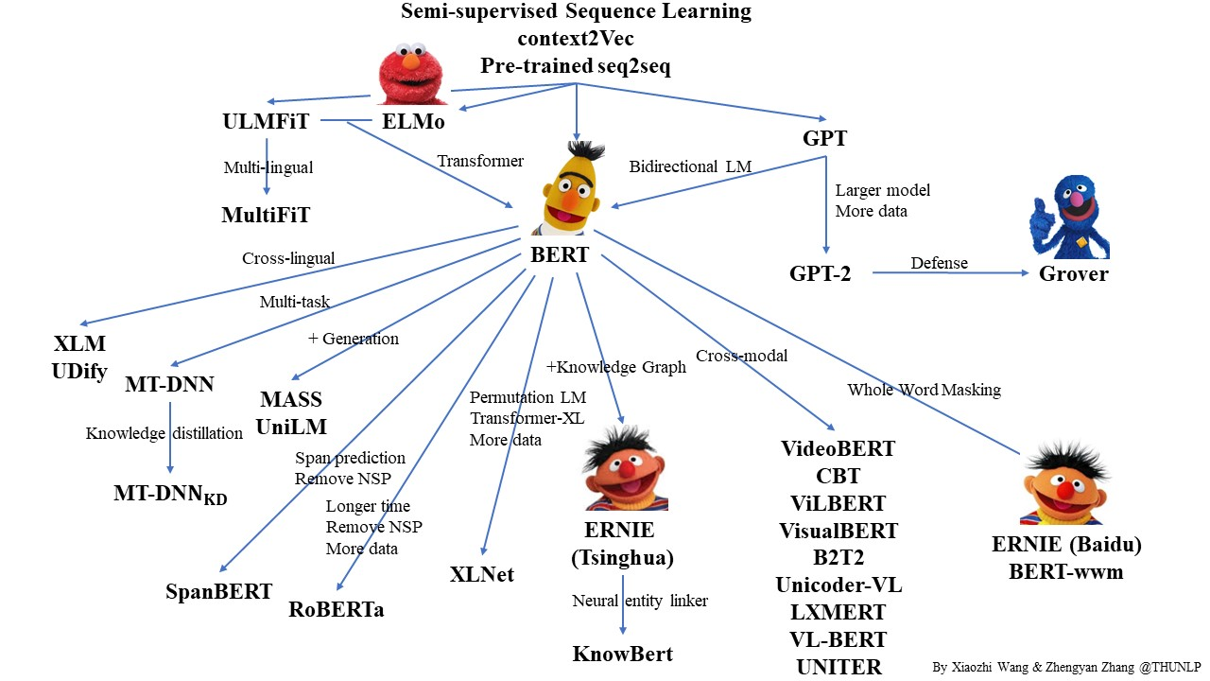
Pre-trained Language Model (PLM)
Source: https://github.com/thunlp/PLMpapers

Slide 30
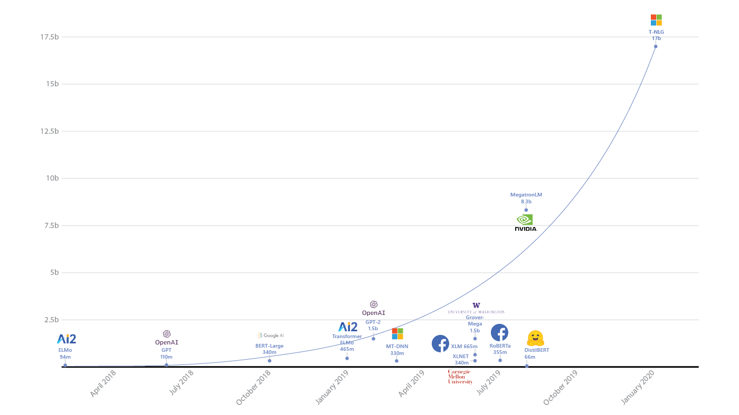
Turing Natural Language Generation (T-NLG)
T-NLG
17b
MegatronLM
8.3b
GPT-2
1.5b
BERT-Large
340m
RoBERTa
355m
DistilBERT
66m
2018
2019
2020
Source: https://www.microsoft.com/en-us/research/blog/turing-nlg-a-17-billion-parameter-language-model-by-microsoft/

Slide 31
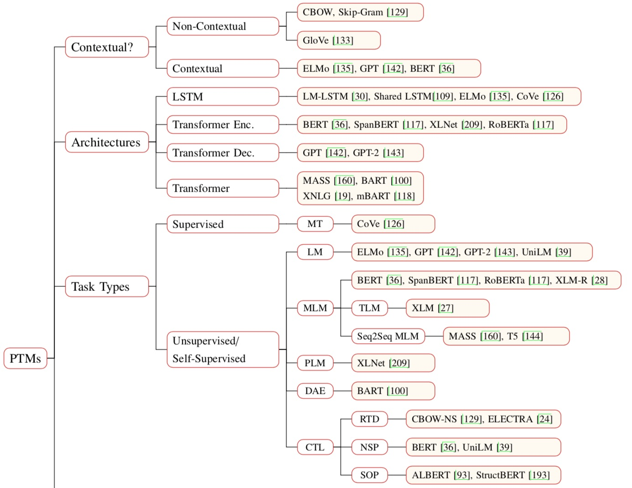
Pre-trained Models (PTM)
Source: Qiu, Xipeng, Tianxiang Sun, Yige Xu, Yunfan Shao, Ning Dai, and Xuanjing Huang. "Pre-trained Models for Natural Language Processing: A Survey." arXiv preprint arXiv:2003.08271 (2020).

Slide 32
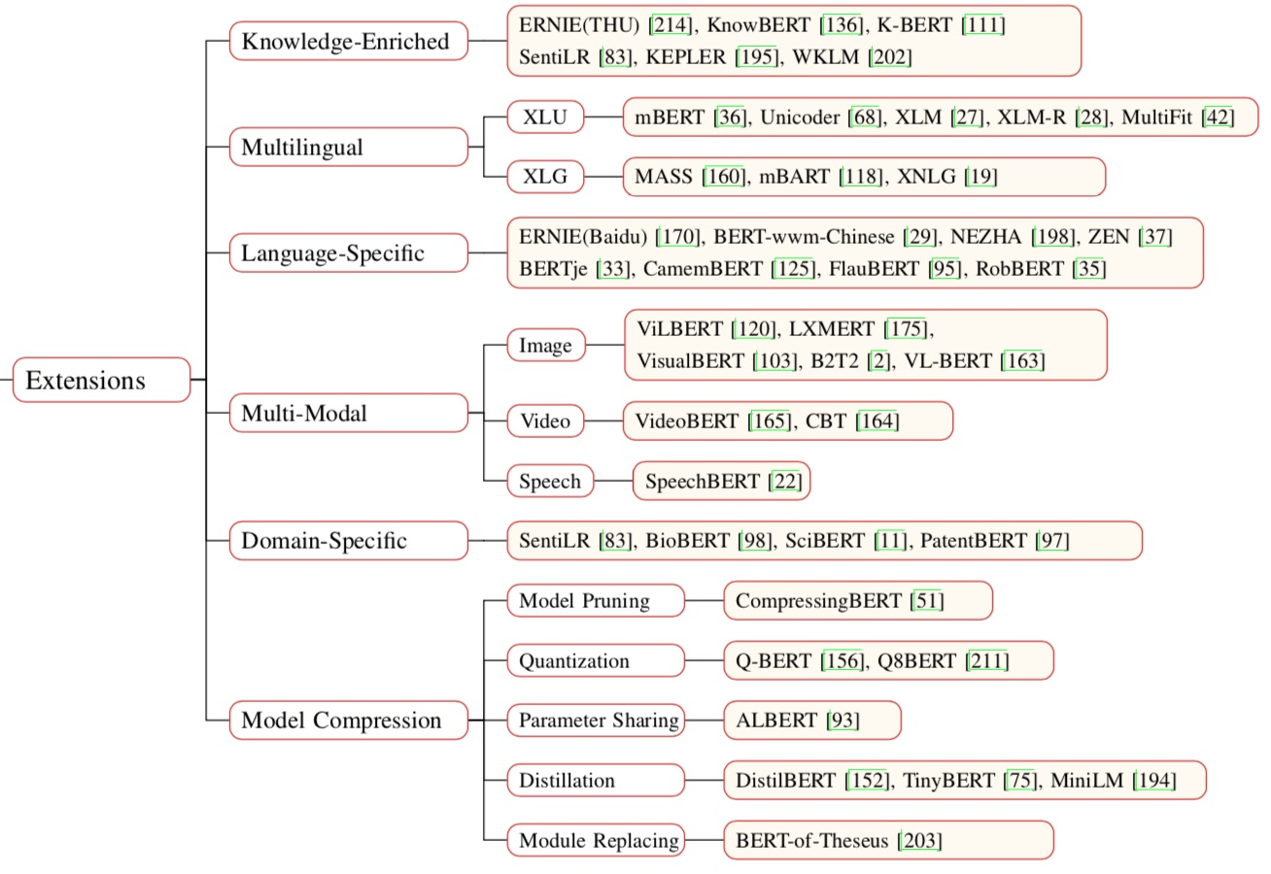
Pre-trained Models (PTM)
Source: Qiu, Xipeng, Tianxiang Sun, Yige Xu, Yunfan Shao, Ning Dai, and Xuanjing Huang. "Pre-trained Models for Natural Language Processing: A Survey." arXiv preprint arXiv:2003.08271 (2020).

Slide 33
Transformers
State-of-the-art Natural Language Processing for TensorFlow 2.0 and PyTorch
Transformers
  pytorch-transformers
  pytorch-pretrained-bert
provides state-of-the-art general-purpose architectures
  (BERT, GPT-2, RoBERTa, XLM, DistilBert, XLNet, CTRL...)
  for Natural Language Understanding (NLU) and
  Natural Language Generation (NLG)
  with over 32+ pretrained models
  in 100+ languages
  and deep interoperability between
  TensorFlow 2.0 and
  PyTorch.
Source: https://github.com/huggingface/transformers

Slide 34
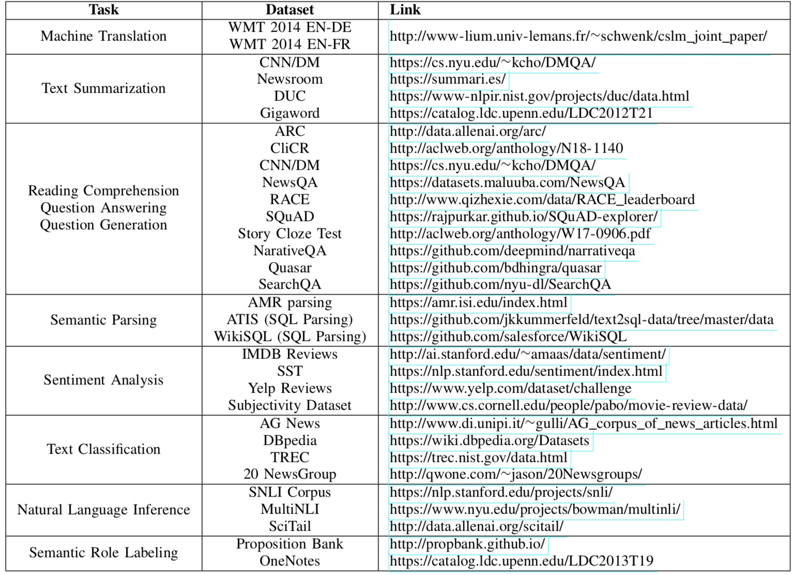
NLP Benchmark Datasets
Source: Amirsina Torfi, Rouzbeh A. Shirvani, Yaser Keneshloo, Nader Tavvaf, and Edward A. Fox (2020).
"Natural Language Processing Advancements By Deep Learning: A Survey." arXiv preprint arXiv:2003.01200.

Slide 35
Summary
Universal Sentence Encoder (USE)
Universal Sentence Encoder Multilingual (USEM)
Semantic Similarity

Slide 36
References
Dipanjan Sarkar (2019),
Text Analytics with Python: A Practitioner’s Guide to Natural Language Processing, Second Edition. APress. https://github.com/Apress/text-analytics-w-python-2e
Benjamin Bengfort, Rebecca Bilbro, and Tony Ojeda (2018),
Applied Text Analysis with Python, O'Reilly Media.
https://www.oreilly.com/library/view/applied-text-analysis/9781491963036/
Daniel Cer, Yinfei Yang, Sheng-yi Kong, Nan Hua, Nicole Limtiaco, Rhomni St. John, Noah Constant, Mario Guajardo-Céspedes, Steve Yuan, Chris Tar, Yun-Hsuan Sung, Brian Strope, Ray Kurzweil (2018). Universal Sentence Encoder. arXiv:1803.11175.
Yinfei Yang, Daniel Cer, Amin Ahmad, Mandy Guo, Jax Law, Noah Constant, Gustavo Hernandez Abrego , Steve Yuan, Chris Tar, Yun-hsuan Sung, Ray Kurzweil (2019). Multilingual Universal Sentence Encoder for Semantic Retrieval.
Xipeng Qiu, Tianxiang Sun, Yige Xu, Yunfan Shao, Ning Dai, and Xuanjing Huang (2020). "Pre-trained Models for Natural Language Processing: A Survey." arXiv preprint arXiv:2003.08271.
HuggingFace (2020), Transformers Notebook, https://huggingface.co/transformers/notebooks.html
The Super Duper NLP Repo, https://notebooks.quantumstat.com/
Min-Yuh Day (2020), Python 101, https://tinyurl.com/aintpupython101

Slide 37
Q & A
深度學習和通用句子嵌入模型 (Deep Learning and
Universal Sentence-Embedding Models)
Min-Yuh Day
戴敏育
Associate Professor
副教授
Institute of Information Management, National Taipei University
國立臺北大學 資訊管理研究所
https://web.ntpu.edu.tw/~myday
2020-08-14

