Slide 1



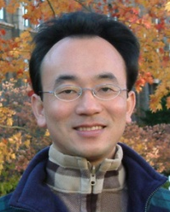
人工智慧任務導向對話系統
(AI Task-Oriented Dialogue System)
中國文化大學應用數學系專題演講
Host: Prof. Chia-Hui Liu
Department of Applied Mathematics, Chinese Culture University
Time: 13:10-15:00, Nov 27, 2020 (Friday)
Place: 理學院會議室 (大義館610), CCU
Address: 55, Hwa-Kang Rd., Yang-Ming-Shan, Taipei, Taiwan
Min-Yuh Day
戴敏育
Associate Professor
副教授
Institute of Information Management, National Taipei University
國立臺北大學 資訊管理研究所
https://web.ntpu.edu.tw/~myday
2020-11-27

Slide 2



戴敏育 博士
(Min-Yuh Day, Ph.D.)
國立台北大學 資訊管理研究所 副教授
中央研究院 資訊科學研究所 訪問學人
國立台灣大學 資訊管理 博士
Publications Co-Chairs, IEEE/ACM International Conference on
Advances in Social Networks Analysis and Mining (ASONAM 2013- )
Program Co-Chair, IEEE International Workshop on
Empirical Methods for Recognizing Inference in TExt (IEEE EM-RITE 2012- )
Publications Chair, The IEEE International Conference on
Information Reuse and Integration (IEEE IRI)

Slide 3
Outline
Artificial Intelligence
Question Answering
Dialogue Systems
Task Oriented Dialogue System

Slide 4
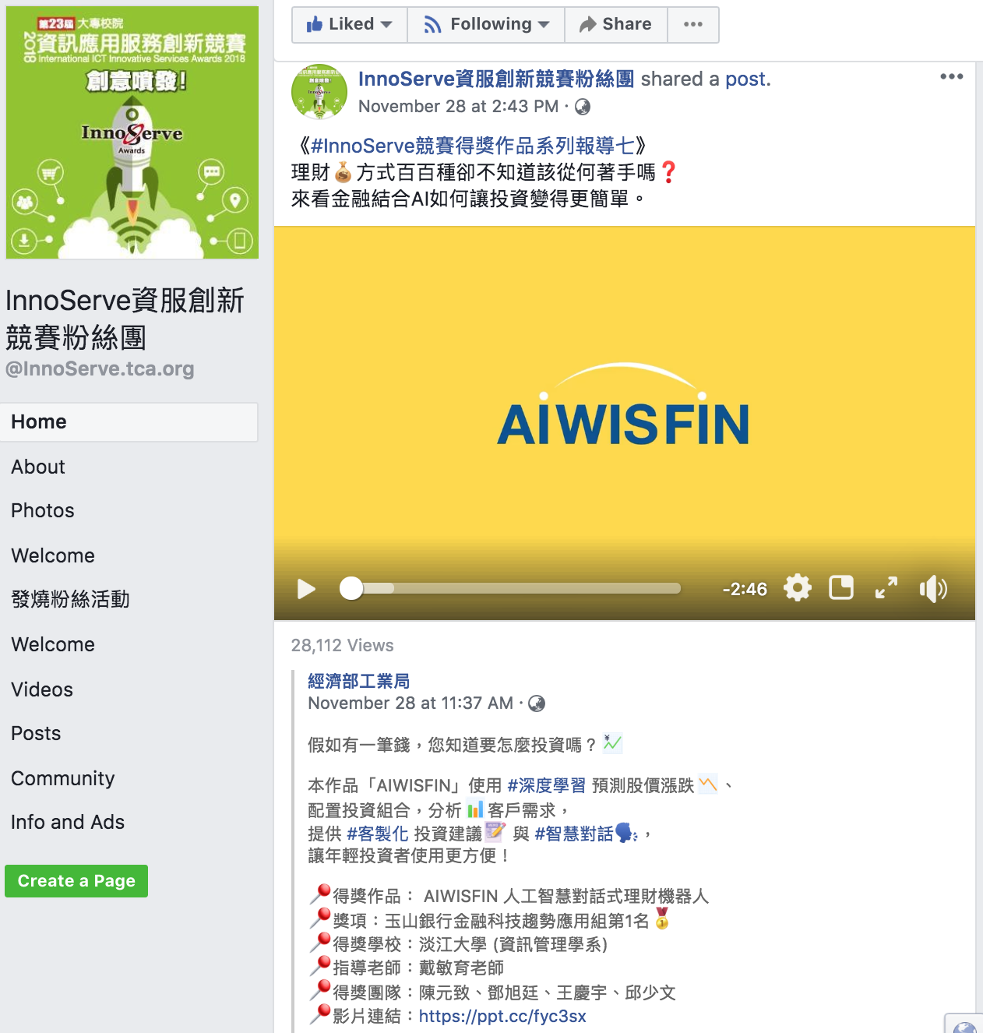
AIWISFIN
AI Conversational Robo-Advisor
(人工智慧對話式理財機器人)
First Place, InnoServe Awards 2018
https://www.youtube.com/watch?v=sEhmyoTXmGk

Slide 5

2018 The 23th International ICT
Innovative Services Awards
(InnoServe Awards 2018)
Annual ICT application competition held for university and college students
The largest and the most significant contest in Taiwan.
More than ten thousand teachers and students from over one hundred universities and colleges have participated in the Contest.
https://innoserve.tca.org.tw/award.aspx

Slide 6
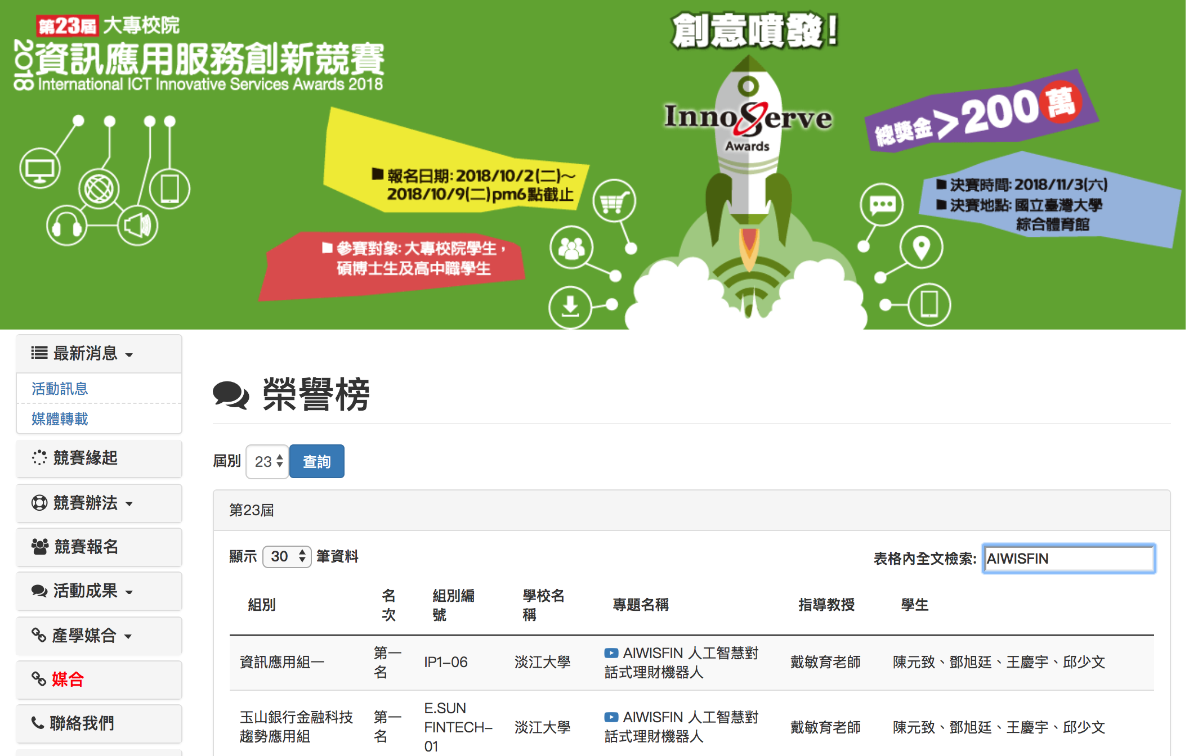
2018 International ICT Innovative Services Awards (InnoServe Awards 2018)
(2018第23屆大專校院資訊應用服務創新競賽)
https://innoserve.tca.org.tw/award.aspx

Slide 7
AI

Slide 8
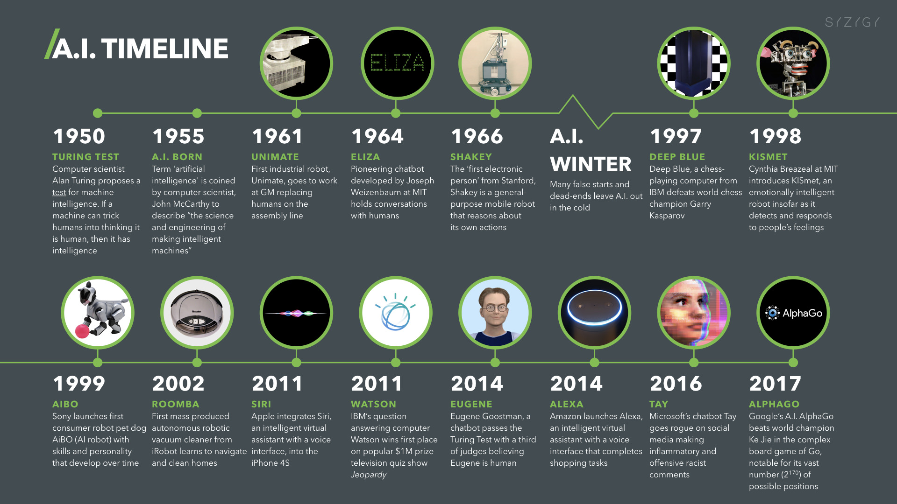
Artificial Intelligence (A.I.) Timeline
Source: https://digitalintelligencetoday.com/artificial-intelligence-timeline-infographic-from-eliza-to-tay-and-beyond/

Slide 9
The Rise of AI
Source: DHL (2018), Artificial Intelligence in Logistics,
http://www.globalhha.com/doclib/data/upload/doc_con/5e50c53c5bf67.pdf/

Slide 10
Definition of
Artificial Intelligence (A.I.)

Slide 11
Artificial Intelligence
“… the science and engineering of making intelligent machines”
(John McCarthy, 1955)
Source: https://digitalintelligencetoday.com/artificial-intelligence-defined-useful-list-of-popular-definitions-from-business-and-science/

Slide 12
Artificial Intelligence
“… technology that thinks and acts like humans”
Source: https://digitalintelligencetoday.com/artificial-intelligence-defined-useful-list-of-popular-definitions-from-business-and-science/

Slide 13
Artificial Intelligence
“… intelligence exhibited by machines or software”
Source: https://digitalintelligencetoday.com/artificial-intelligence-defined-useful-list-of-popular-definitions-from-business-and-science/

Slide 14
4 Approaches of AI
Thinking Humanly | Thinking Rationally
Acting Humanly | Acting Rationally
Source: Stuart Russell and Peter Norvig (2020), Artificial Intelligence: A Modern Approach, 4th Edition, Pearson

Slide 15
4 Approaches of AI
2. Thinking Humanly: The Cognitive Modeling Approach | 3. Thinking Rationally: The “Laws of Thought” Approach
1. Acting Humanly: The Turing Test Approach (1950) | 4. Acting Rationally: The Rational Agent Approach
Source: Stuart Russell and Peter Norvig (2020), Artificial Intelligence: A Modern Approach, 4th Edition, Pearson

Slide 16
AI Acting Humanly:
The Turing Test Approach
(Alan Turing, 1950)
Knowledge Representation
Automated Reasoning
Machine Learning (ML)
  Deep Learning (DL)
Computer Vision (Image, Video)
Natural Language Processing (NLP)
Robotics
Source: Stuart Russell and Peter Norvig (2020), Artificial Intelligence: A Modern Approach, 4th Edition, Pearson

Slide 17


Tamkang University
IMTKU
Emotional Dialogue System for
Short Text Conversation
at
NTCIR-14 STC-3 (CECG) Task
NTCIR-14 Conference, June 10-13, 2019, Tokyo, Japan

Slide 18

Tamkang University
2011
Tamkang
University
IMTKU Textual Entailment System for
Recognizing Inference in Text
at NTCIR-9 RITE
Department of Information Management
Tamkang University, Taiwan
Min-Yuh Day
Chun Tu
myday@mail.tku.edu.tw
NTCIR-9 Workshop, December 6-9, 2011, Tokyo, Japan

Slide 19



IMTKU Textual Entailment System for
Recognizing Inference in Text at NTCIR-10 RITE-2
Tamkang University
2013
Tamkang
University
Department of Information Management
Tamkang University, Taiwan
Min-Yuh Day
Chun Tu
Hou-Cheng Vong
Shih-Wei Wu
Shih-Jhen Huang
myday@mail.tku.edu.tw
NTCIR-10 Conference, June 18-21, 2013, Tokyo, Japan

Slide 20
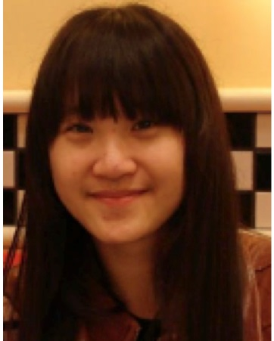




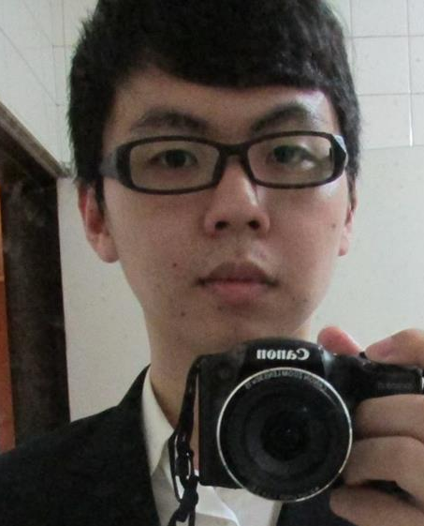
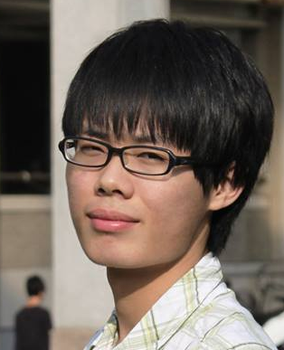

IMTKU Textual Entailment System for
Recognizing Inference in Text at NTCIR-11 RITE-VAL
2014
Tamkang University
Min-Yuh Day
Ya-Jung Wang
Che-Wei Hsu
En-Chun Tu
Huai-Wen Hsu
Yu-An Lin
Shang-Yu Wu
Yu-Hsuan Tai
Cheng-Chia Tsai
NTCIR-11 Conference, December 8-12, 2014, Tokyo, Japan

Slide 21

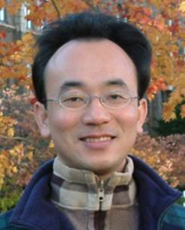
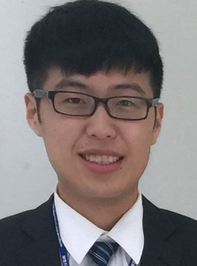
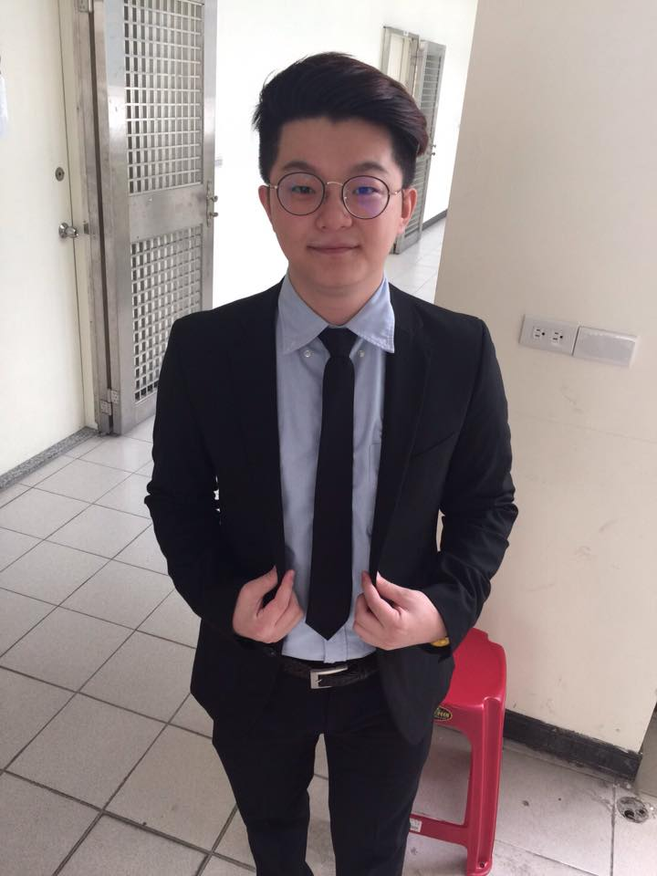
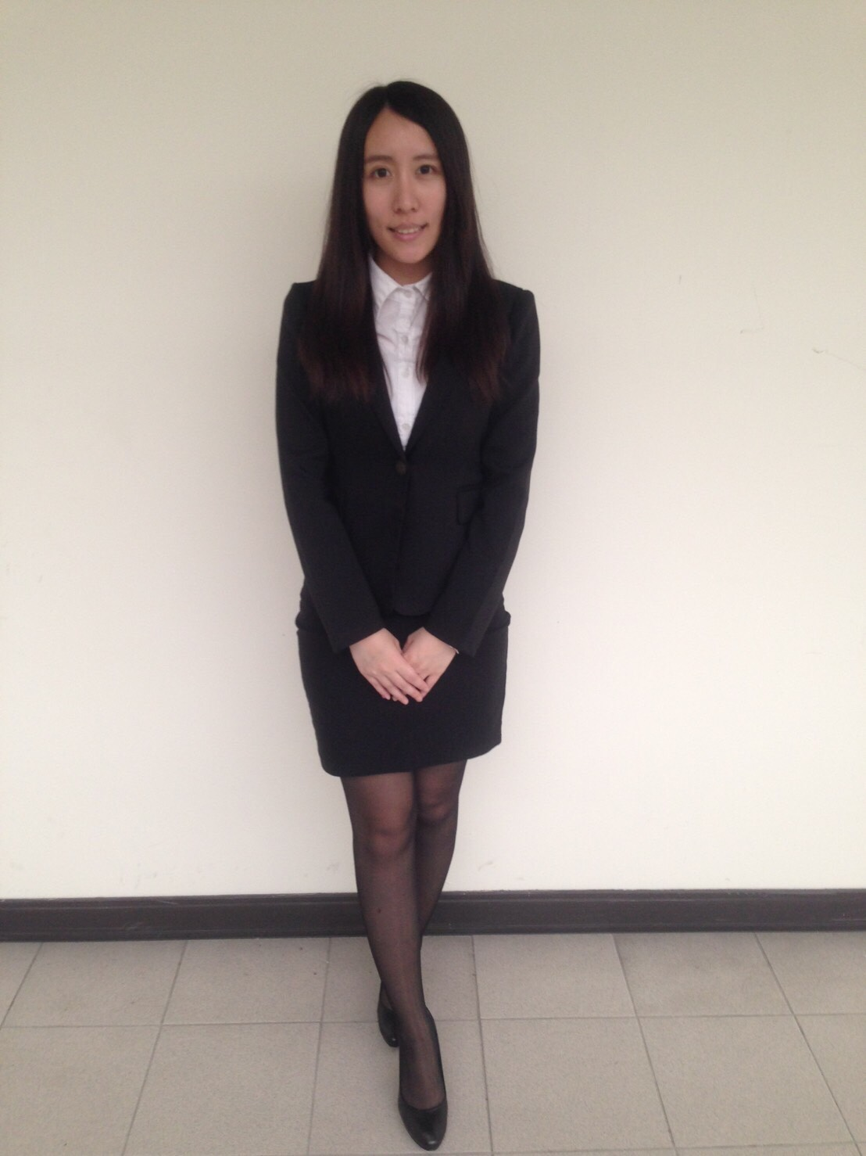
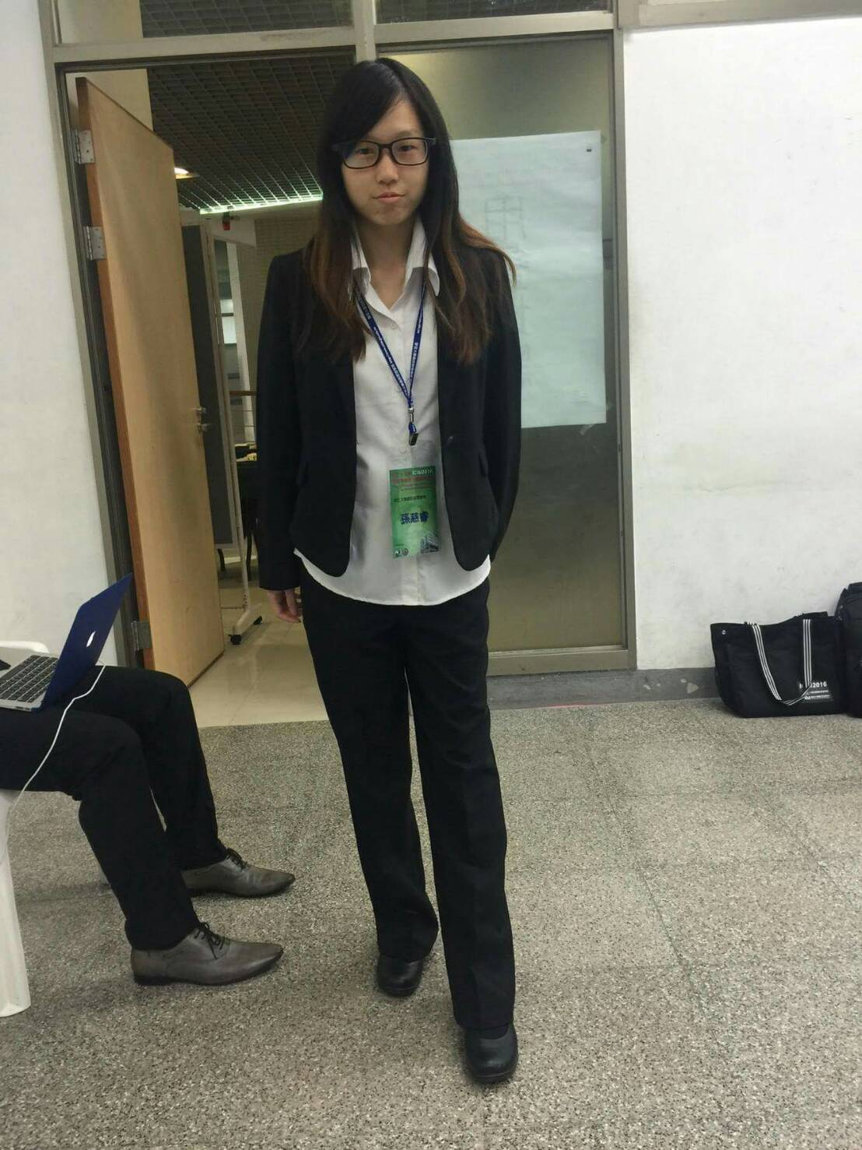
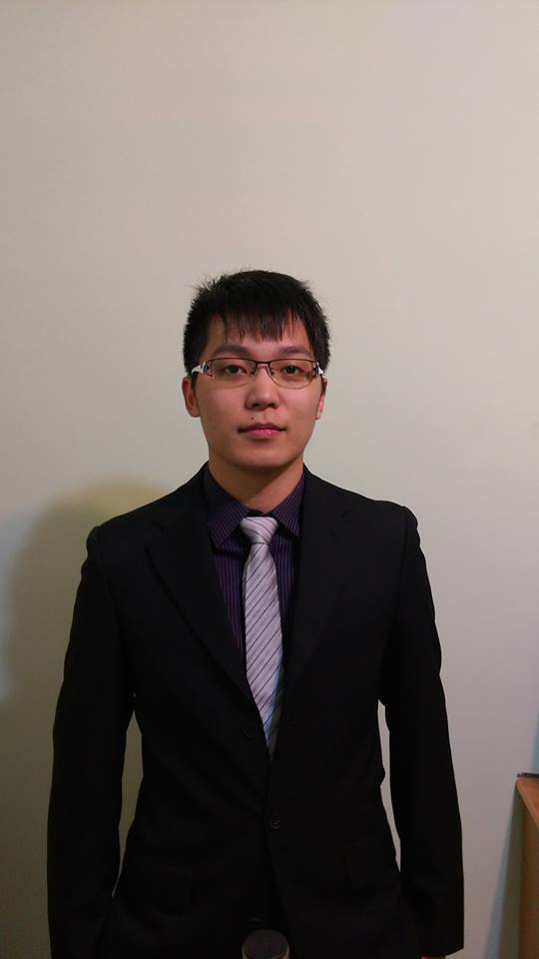
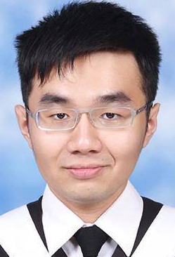
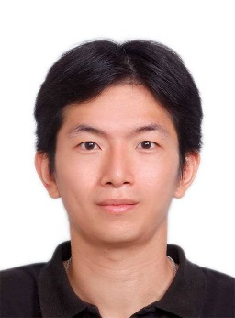
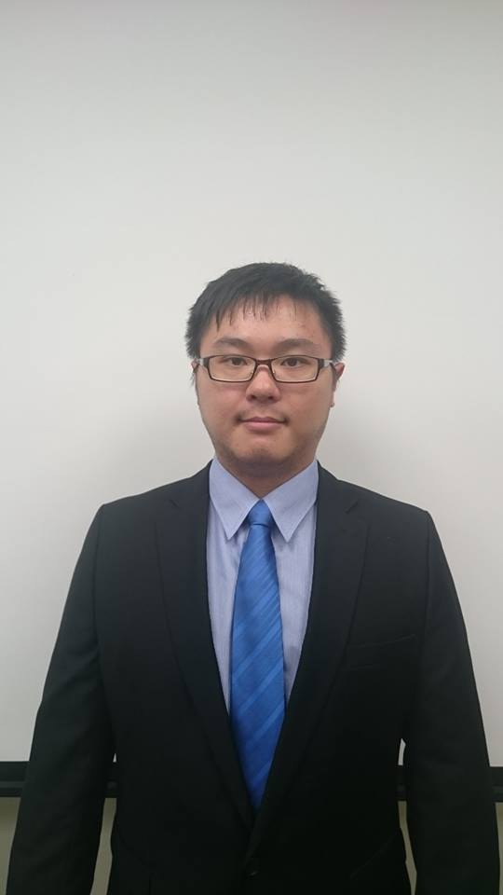
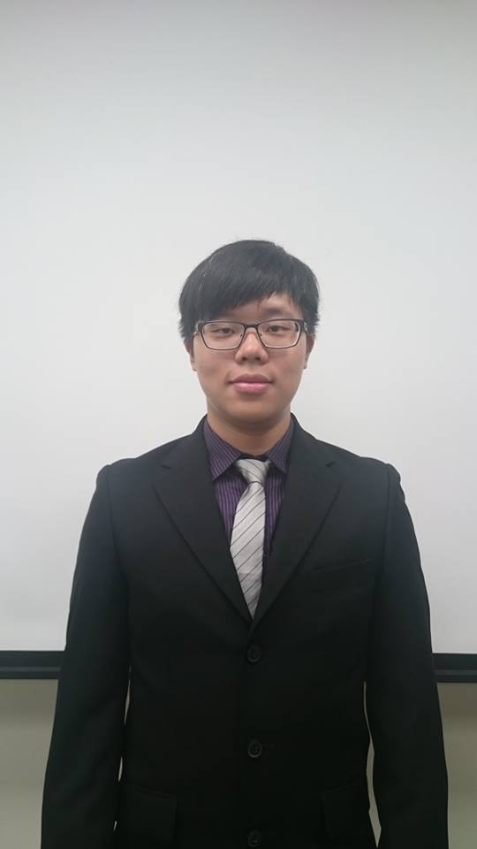
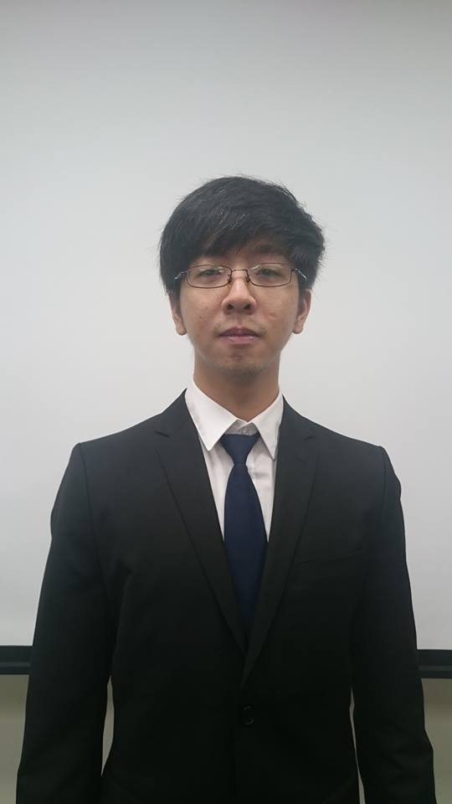
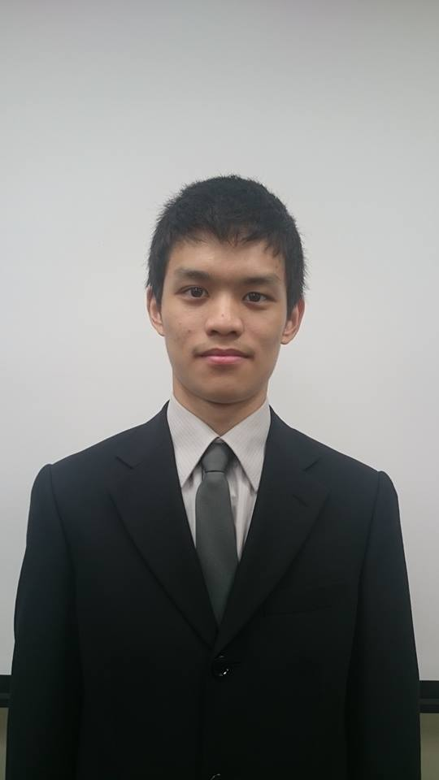
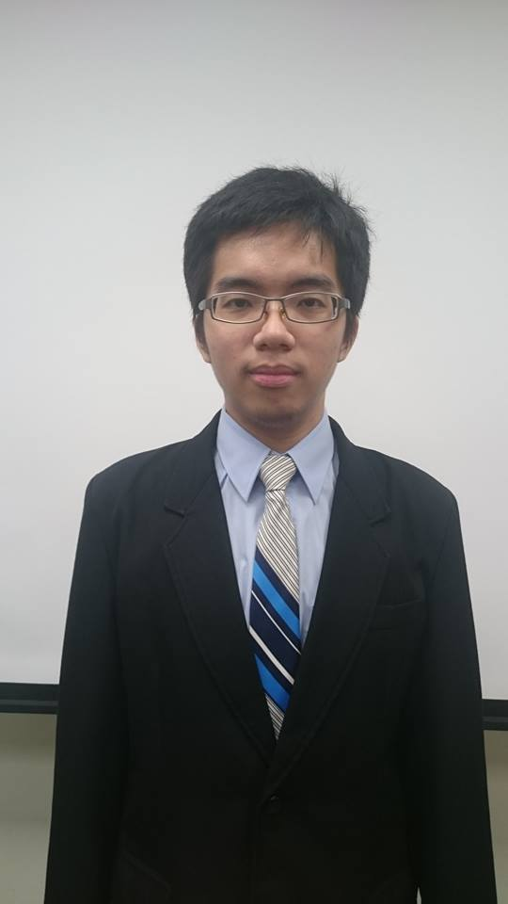
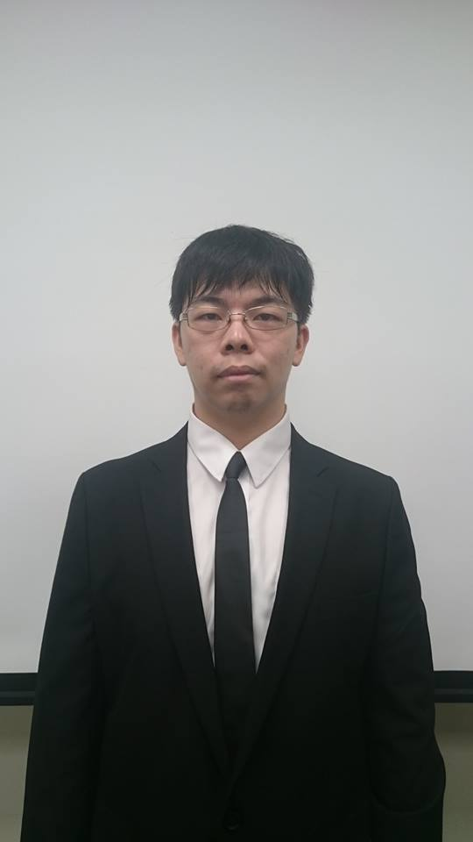
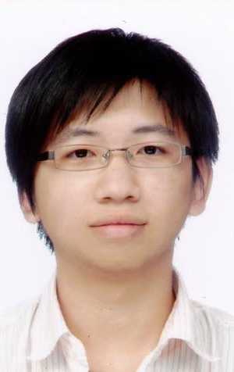
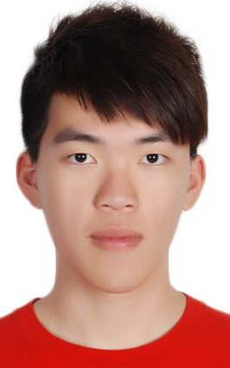
IMTKU Question Answering System for
World History Exams at NTCIR-12 QA Lab2
2016
Tamkang University
Department of Information Management
Tamkang University, Taiwan
Sagacity Technology
Min-Yuh Day
Cheng-Chia Tsai
Wei-Chun Chung
Hsiu-Yuan Chang
Tzu-Jui Sun
Yuan-Jie Tsai
Jin-Kun Lin
Cheng-Hung Lee
Yu-Ming Guo
Yue-Da Lin
Wei-Ming Chen
Yun-Da Tsai
Cheng-Jhih Han
Yi-Jing Lin
Yi-Heng Chiang
Ching-Yuan Chien
myday@mail.tku.edu.tw
NTCIR-12 Conference, June 7-10, 2016, Tokyo, Japan

Slide 22
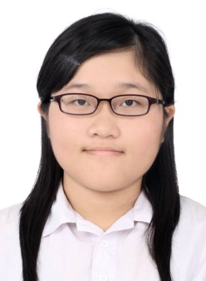

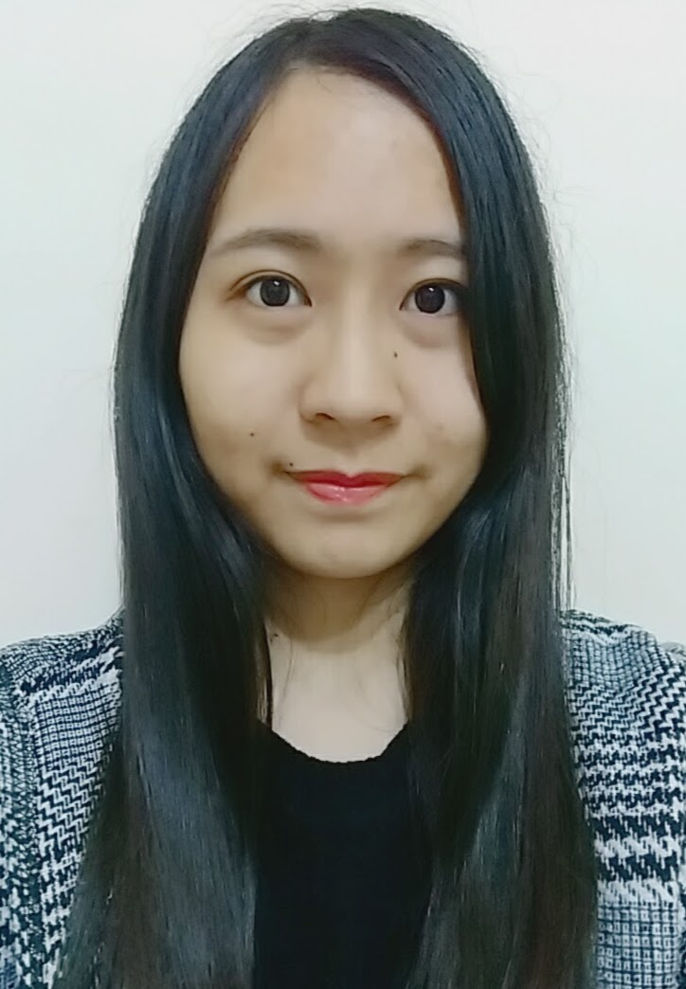

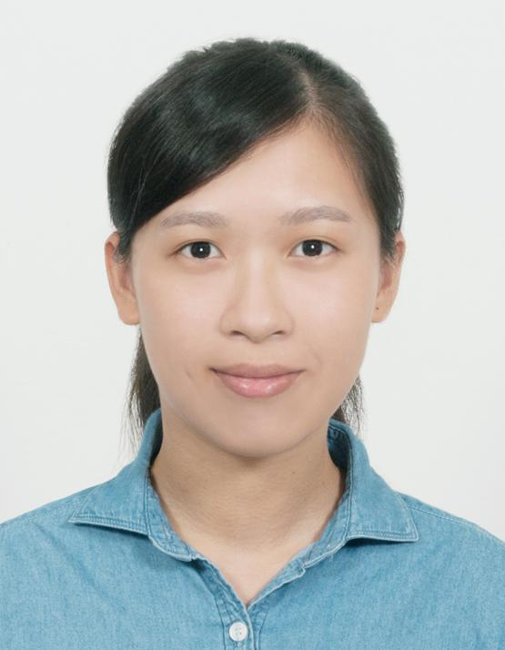
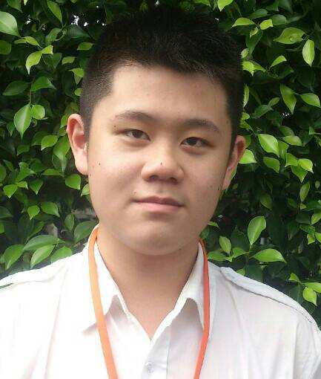
IMTKU Question Answering System for
World History Exams at NTCIR-13 QALab-3
2017
Tamkang University
Department of Information Management
Tamkang University, Taiwan
Min-Yuh Day
Chao-Yu Chen
Wanchu Huang
Shi-Ya Zheng
I-Hsuan Huang
Tz-Rung Chen
Min-Chun Kuo
Yue-Da Lin
Yi-Jing Lin
myday@mail.tku.edu.tw
NTCIR-13 Conference, December 5-8, 2017, Tokyo, Japan

Slide 23
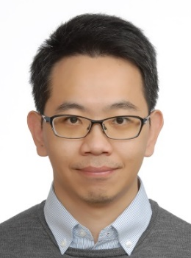


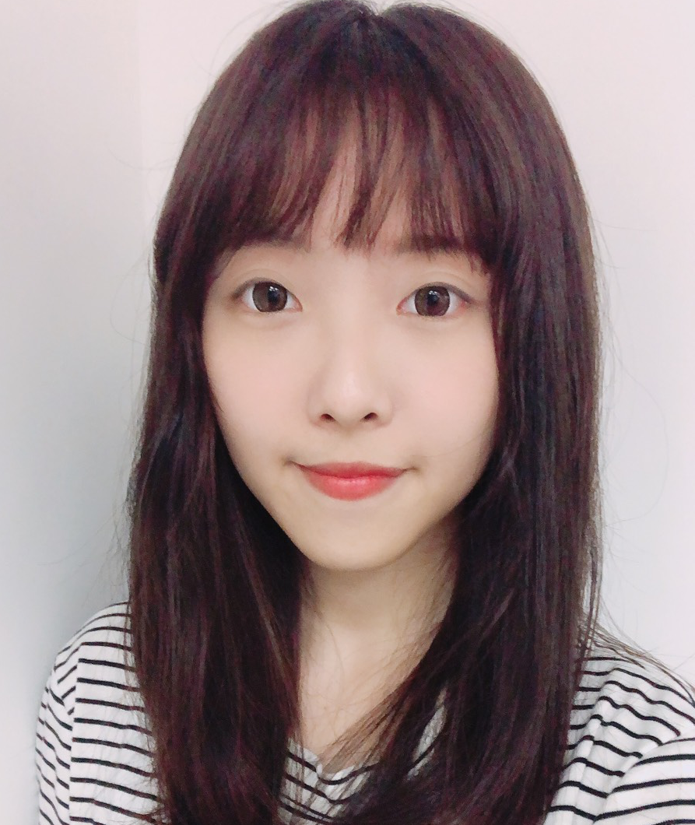
IMTKU Emotional Dialogue System for
Short Text Conversation at NTCIR-14 STC-3 (CECG) Task
2019
Tamkang University
Department of Information Management
Tamkang University, Taiwan
Min-Yuh Day
Chi-Sheng Hung
Yi-Jun Xie
Jhih-Yi Chen
Yu-Ling Kuo
Jian-Ting Lin
myday@mail.tku.edu.tw
NTCIR-14 Conference, June 10-13, 2019, Tokyo, Japan

Slide 24
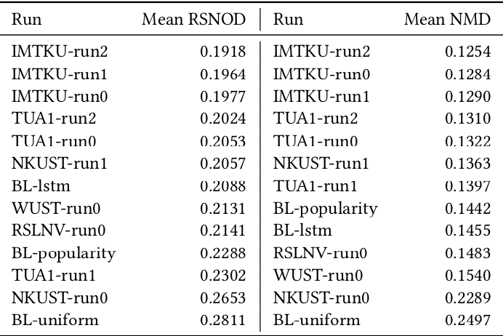
NTCIR-15 Dialogue Evaluation (DialEval-1) Task
Dialogue Quality (DQ) and Nugget Detection (ND)
Chinese Dialogue Quality (S-score) Results (Zeng et al., 2020)
2020
Source: Zeng, Zhaohao, Sosuke Kato, Tetsuya Sakai, and Inho Kang (2020), “Overview of the NTCIR-15 Dialogue Evaluation (DialEval-1) Task”, Proceedings of NTCIR-15, 2020

Slide 25
IMTKU System Architecture for NTCIR-13 QALab-3
Question
(XML)
JA&EN Translator
Complex Essay
Question Analysis
Simple Essay
Stanford CoreNLP
True-or-False
Factoid
Wikipedia
Document Retrieval
Slot-Filling
Unique
Answer Extraction
Answer Generation
Word Embedding
Wiki Word2Vec
Answer
(XML)
NTCIR-13 Conference, December 5-8, 2017, Tokyo, Japan

Slide 26
System Architecture of
Intelligent Dialogue and Question Answering System
User Question Input
RNN
LSTM
GRU
Deep Learning
TensorFlow
Dialogue Intention Detection
Question Analysis
Python
NLTK
AIML KB
AIML
Dialogue
Engine
Dialogue KB
Document Retrieval
IR
Answer Extraction
Cloud
Resource
Real Time
Dialogue
API
Answer Generation
Answer Validation
Deep Learning
System Response Generator
Answer

Slide 27
IMTKU Emotional Dialogue System Architecture
1
3
4
Retrieval-Based Model
Emotion Classification
Model
Response
Ranking
Generation-Based Model
2
NTCIR-14 Conference, June 10-13, 2019, Tokyo, Japan

Slide 28
The system architecture of
IMTKU retrieval-based model for NTCIR-14 STC-3
Retrieval-Based Model
1
Post
Corpus
Word
Segmentation
Building
Index
Retrieval Model
Keyword
Boolean
Query
Distinct
Result Data
Word2Vec Similarity
Ranking
Solr
Matching
Emotion
Matching
Emotion
Classification
Retrieval-Based
Response
NTCIR-14 Conference, June 10-13, 2019, Tokyo, Japan

Slide 29
The system architecture of
IMTKU generation-based model for NTCIR-14 STC-3
Generation-Based Model
2
Training Data
Post
Building Word Index
Word Segmentation
Short Text
Emotion Classifier
Word
Embedding
Training Data
Seq2seq model
Trained Model
Generative Model
Emotion Matching
Generation-Based
Response
Word2Vec Similarity
Ranking
NTCIR-14 Conference, June 10-13, 2019, Tokyo, Japan

Slide 30
The system architecture of
IMTKU emotion classification model for NTCIR-14 STC-3
Emotion Classification Model
3
Training
Dataset
MLP
LSTM
BiLSTM
Corpus
Emotion
Classification
Testing
Dataset
Emotion
Classification Model
Emotion
Prediction
NTCIR-14 Conference, June 10-13, 2019, Tokyo, Japan

Slide 31
The system architecture of
IMTKU Response Ranking for NTCIR-14 STC-3
Response Ranking
4
STC3 Corpus
Chinese Segmentation
using
Jieba
Stop Words
Removal
Word2Vec
1.2 million data
(300 dimensions)
Vector of Corpus
NTCIR-14 Conference, June 10-13, 2019, Tokyo, Japan

Slide 32
Short Text Conversation Task
(STC-3)
Chinese Emotional Conversation Generation (CECG) Subtask
Source: http://coai.cs.tsinghua.edu.cn/hml/challenge.html

Slide 33
NTCIR Short Text Conversation
STC-1, STC-2, STC-3
Source: https://waseda.app.box.com/v/STC3atNTCIR-14

Slide 34
Chatbots: Evolution of UI/UX
Source: https://bbvaopen4u.com/en/actualidad/want-know-how-build-conversational-chatbot-here-are-some-tools

Slide 35
AI Humanoid
Robo-Advisor

Slide 36
AI Humanoid Robo-Advisor for Multi-channel Conversational Commerce
AI Portfolio
Asset Allocation
Multichannel
Platforms
Web
LINE
Facebook
Humanoid Robot
AI Conversation
Dialog System

Slide 37
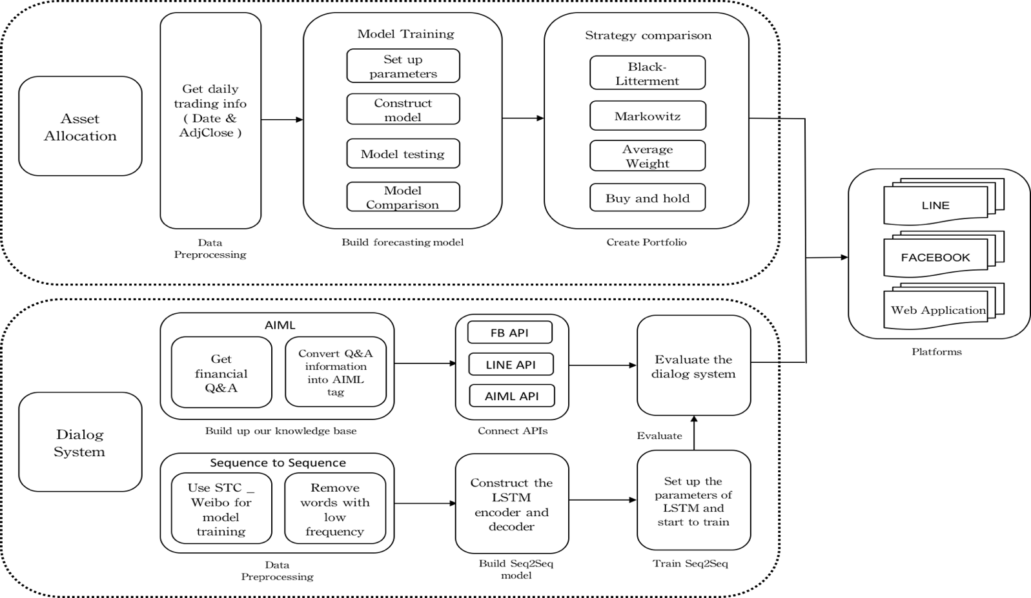
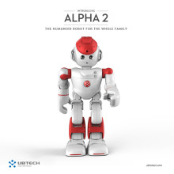
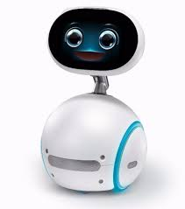
System Architecture of
AI Humanoid Robo-Advisor
AI Humanoid
Robo-advisor

Slide 38
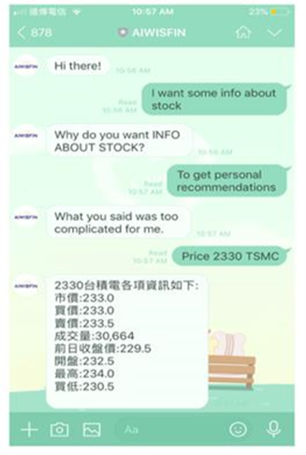
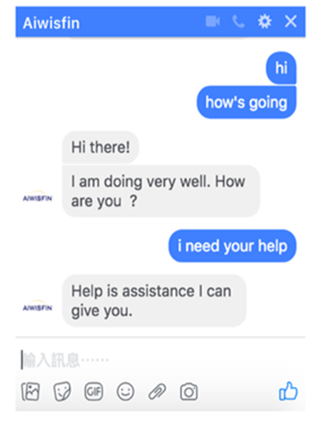
Conversational Model
(LINE, FB Messenger)

Slide 39


Conversational Robo-Advisor
Multichannel UI/UX
Robots
ALPHA 2
ZENBO

Slide 40
AI Dialogue System

Slide 41
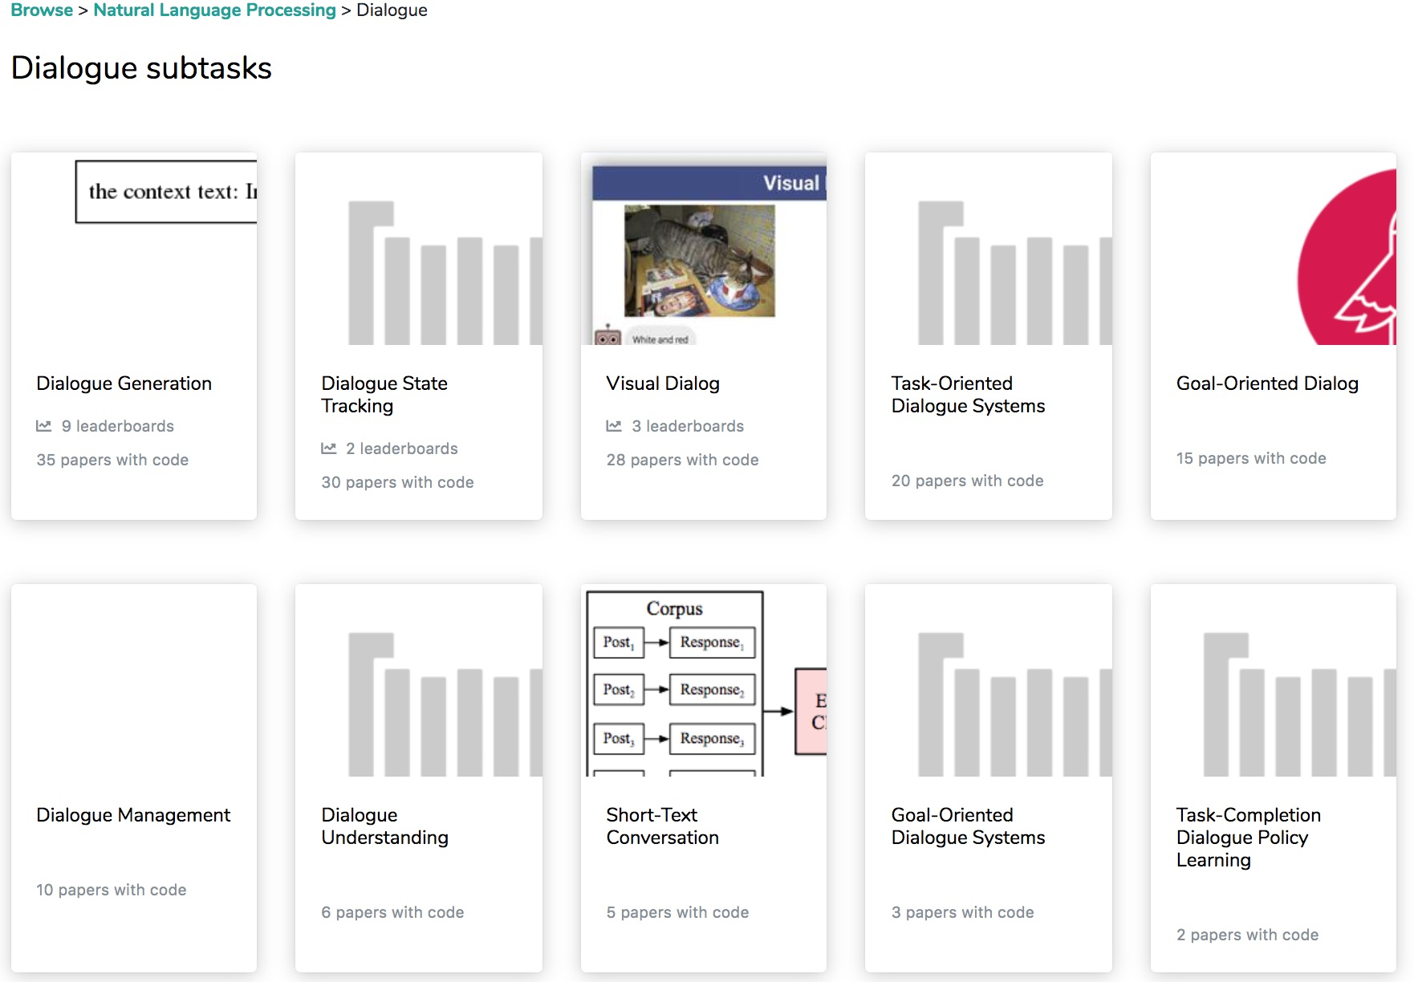
Dialogue Subtasks
Dialogue Generation
Task-Oriented Dialogue Systems
Short-Text Conversation
Source: https://paperswithcode.com/area/natural-language-processing/dialogue

Slide 42
Chatbot
Dialogue System
Intelligent Agent

Slide 43
Chatbot
Source: https://www.mdsdecoded.com/blog/the-rise-of-chatbots/

Slide 44
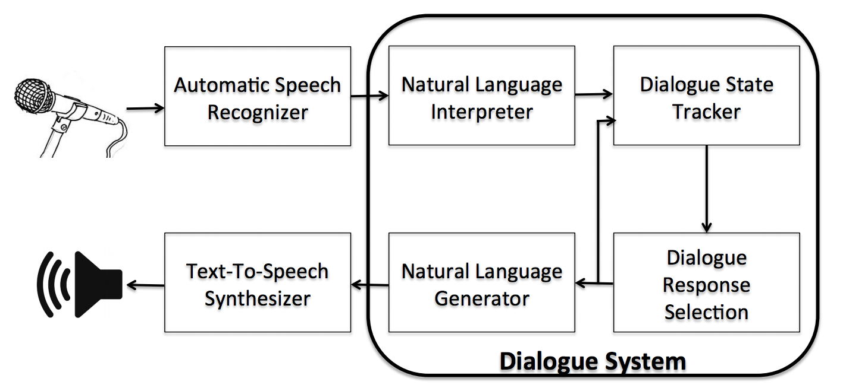
Dialogue System
Source: Serban, I. V., Lowe, R., Charlin, L., & Pineau, J. (2015). A survey of available corpora for building data-driven dialogue systems. arXiv preprint arXiv:1512.05742.

Slide 45
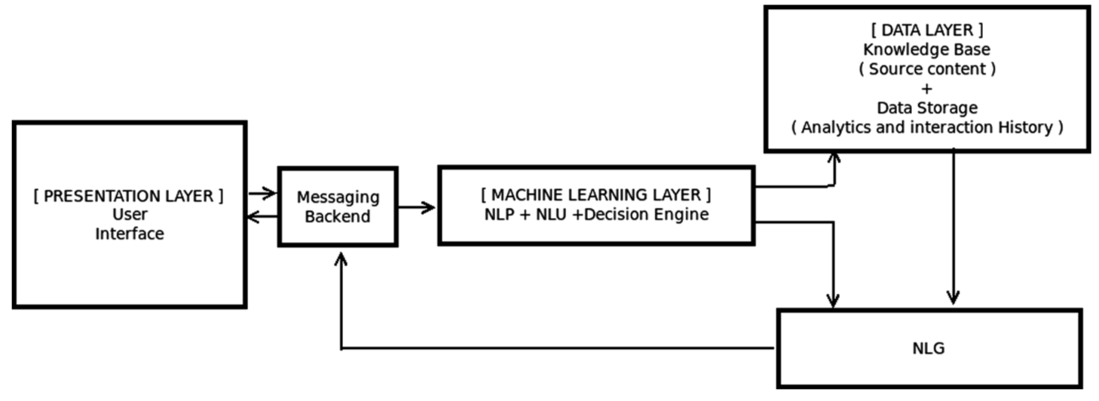
Overall Architecture of
Intelligent Chatbot
Source: Borah, Bhriguraj, Dhrubajyoti Pathak, Priyankoo Sarmah, Bidisha Som, and Sukumar Nandi. "Survey of Textbased Chatbot in Perspective of Recent Technologies." In International Conference on Computational Intelligence, Communications, and Business Analytics, pp. 84-96. Springer, Singapore, 2018.

Slide 46
Can machines think?
(Alan Turing ,1950)
Source: Cahn, Jack. "CHATBOT: Architecture, Design, & Development."
PhD diss., University of Pennsylvania, 2017.

Slide 47
Chatbot
“online human-computer dialog system with natural language.”
Source: Cahn, Jack. "CHATBOT: Architecture, Design, & Development."
PhD diss., University of Pennsylvania, 2017.

Slide 48
Chatbot Conversation Framework
Source: https://chatbotslife.com/ultimate-guide-to-leveraging-nlp-machine-learning-for-you-chatbot-531ff2dd870c

Slide 49
Chatbots
Bot Maturity Model
Customers want to have simpler means to interact with businesses and
get faster response to a question or complaint.
Source: https://www.capgemini.com/2017/04/how-can-chatbots-meet-expectations-introducing-the-bot-maturity/

Slide 50
From
E-Commerce to
Conversational Commerce: Chatbots and
Virtual Assistants
Source: http://www.guided-selling.org/from-e-commerce-to-conversational-commerce/

Slide 51
Conversational Commerce: eBay AI Chatbots
Source: https://www.forbes.com/sites/rachelarthur/2017/07/19/conversational-commerce-ebay-ai-chatbot/

Slide 52
Hotel Chatbot
Intent Detection
Slot Filling
Source: https://sdtimes.com/amazon/guest-view-capitalize-amazon-lex-available-general-public/

Slide 53
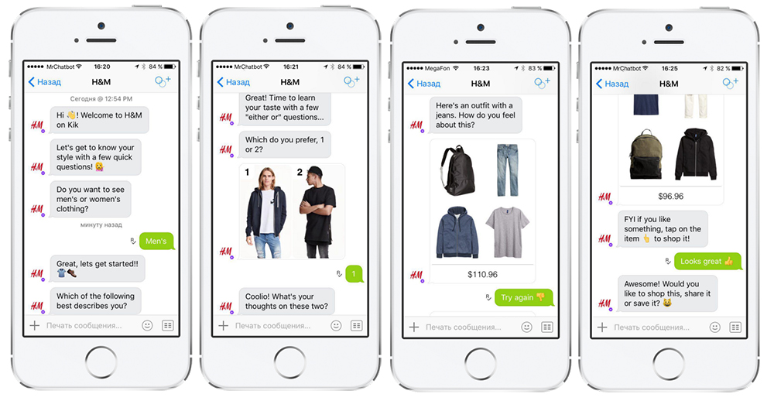
H&M’s Chatbot on Kik
Source: http://www.guided-selling.org/from-e-commerce-to-conversational-commerce/

Slide 54
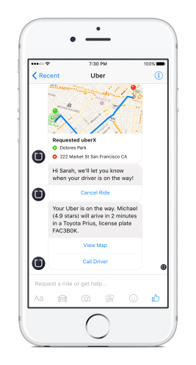
Uber’s Chatbot on Facebook’s Messenger
Uber’s chatbot on Facebook’s messenger
- one main benefit: it loads much faster than the Uber app
Source: http://www.guided-selling.org/from-e-commerce-to-conversational-commerce/

Slide 55
Bot Life Cycle and Platform
Ecosystem

Slide 56
The Bot Lifecycle
Source: https://chatbotsmagazine.com/the-bot-lifecycle-1ff357430db7

Slide 57
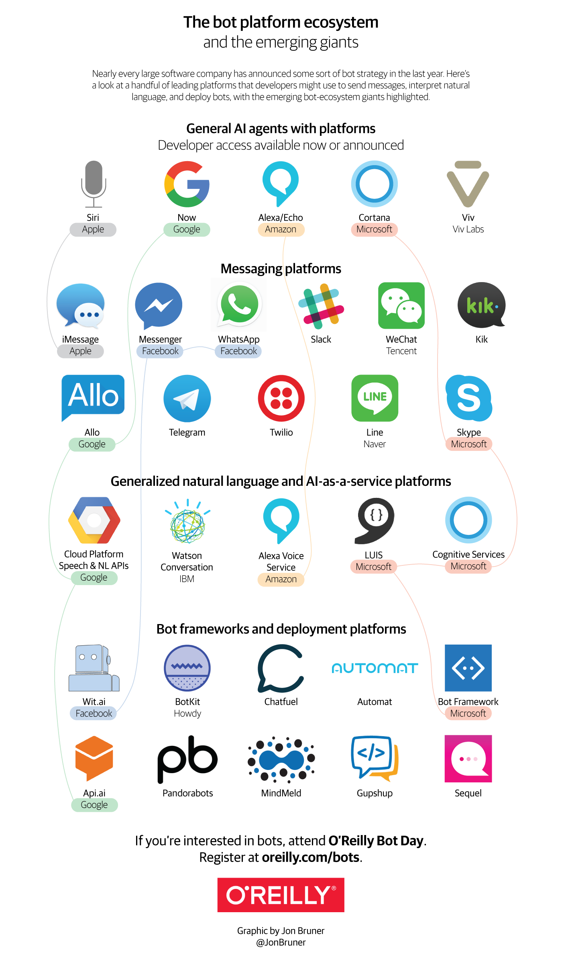
Source: https://www.oreilly.com/ideas/infographic-the-bot-platform-ecosystem

Slide 58
Source: https://www.oreilly.com/ideas/infographic-the-bot-platform-ecosystem

Slide 59
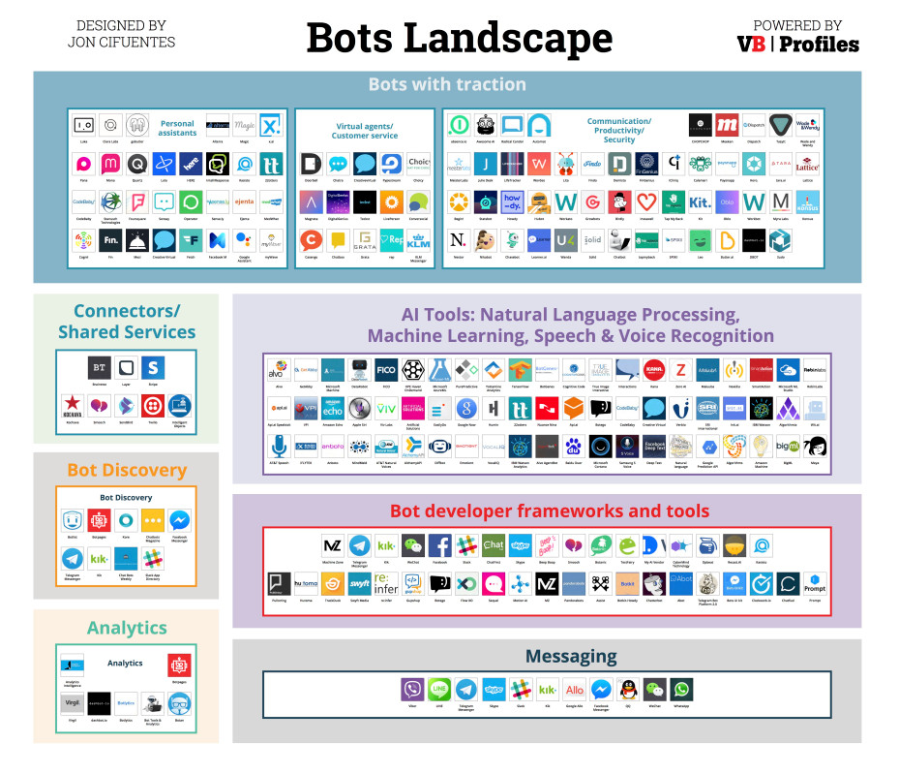
Source: https://venturebeat.com/2016/08/11/introducing-the-bots-landscape-170-companies-4-billion-in-funding-thousands-of-bots/

Slide 60
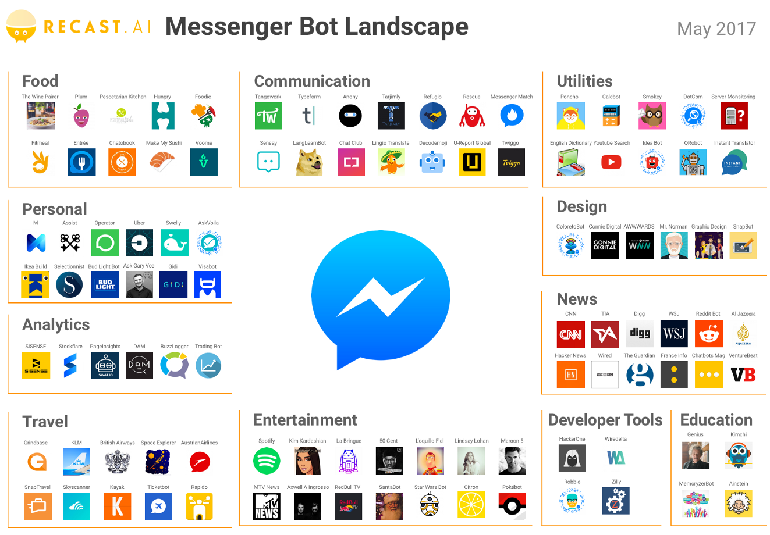
Source: https://medium.com/@RecastAI/2017-messenger-bot-landscape-a-public-spreadsheet-gathering-1000-messenger-bots-f017fdb1448a /

Slide 61
How to Build Chatbots
Source: Igor Bobriakov (2018), https://activewizards.com/blog/a-comparative-analysis-of-chatbots-apis/

Slide 62
Chatbot Frameworks and AI Services
Bot Frameworks
  Botkit
  Microsoft Bot Framework
  Rasa NLU
AI Services
  Wit.ai
  api.ai
  LUIS.ai
  IBM Watson
Source: Igor Bobriakov (2018), https://activewizards.com/blog/a-comparative-analysis-of-chatbots-apis/

Slide 63
Chatbot Frameworks
Source: Igor Bobriakov (2018), https://activewizards.com/blog/a-comparative-analysis-of-chatbots-apis/

Slide 64
Source: Igor Bobriakov (2018), https://activewizards.com/blog/a-comparative-analysis-of-chatbots-apis/

Slide 65
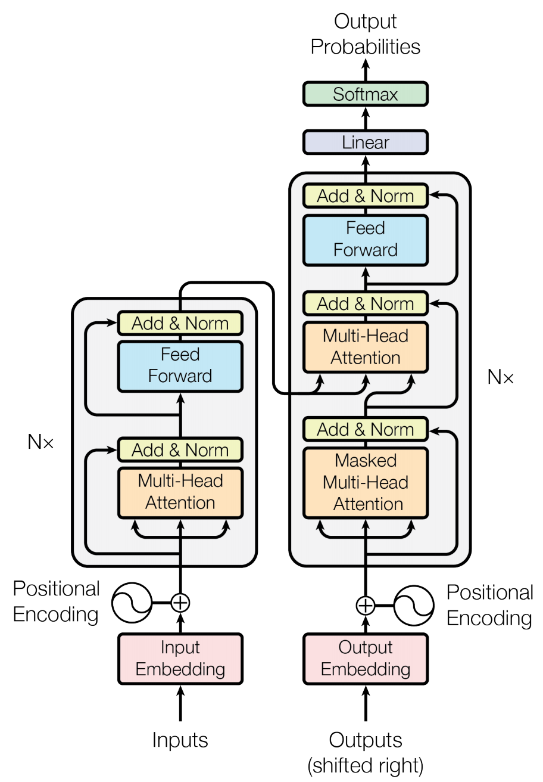
Transformer (Attention is All You Need)
(Vaswani et al., 2017)
Source: Vaswani, Ashish, Noam Shazeer, Niki Parmar, Jakob Uszkoreit, Llion Jones, Aidan N. Gomez, Łukasz Kaiser, and Illia Polosukhin. "Attention is all you need." In Advances in neural information processing systems, pp. 5998-6008. 2017.

Slide 66
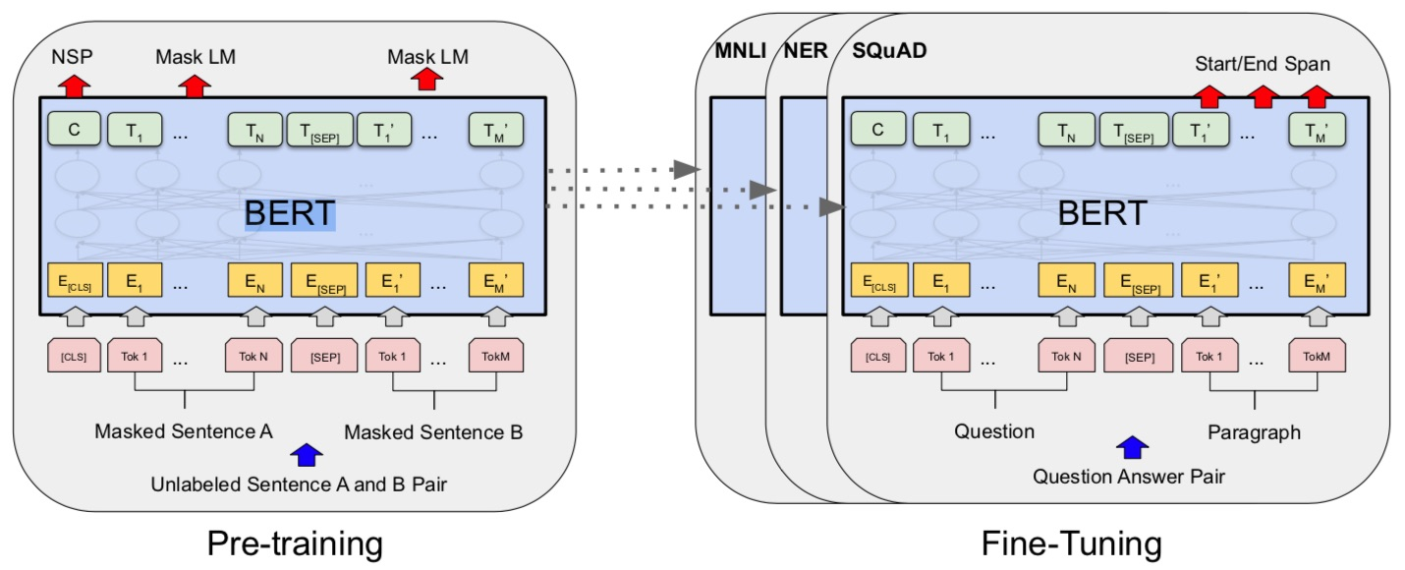
BERT: Pre-training of Deep Bidirectional Transformers for Language Understanding
BERT (Bidirectional Encoder Representations from Transformers)
Overall pre-training and fine-tuning procedures for BERT
Source: Devlin, Jacob, Ming-Wei Chang, Kenton Lee, and Kristina Toutanova (2018).
"Bert: Pre-training of deep bidirectional transformers for language understanding." arXiv preprint arXiv:1810.04805.

Slide 67
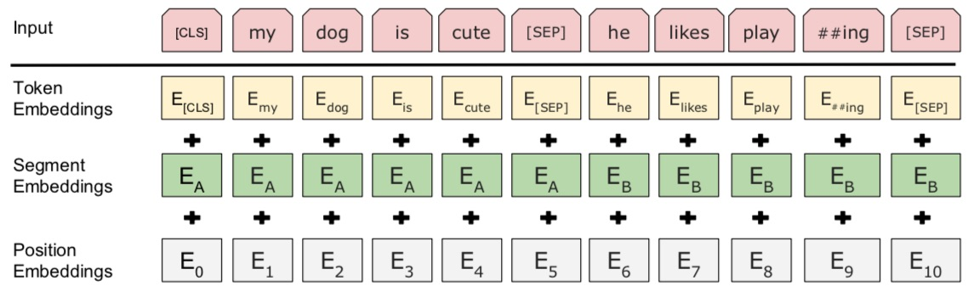
BERT: Pre-training of Deep Bidirectional Transformers for Language Understanding
BERT (Bidirectional Encoder Representations from Transformers)
BERT input representation
Source: Devlin, Jacob, Ming-Wei Chang, Kenton Lee, and Kristina Toutanova (2018).
"Bert: Pre-training of deep bidirectional transformers for language understanding." arXiv preprint arXiv:1810.04805.

Slide 68
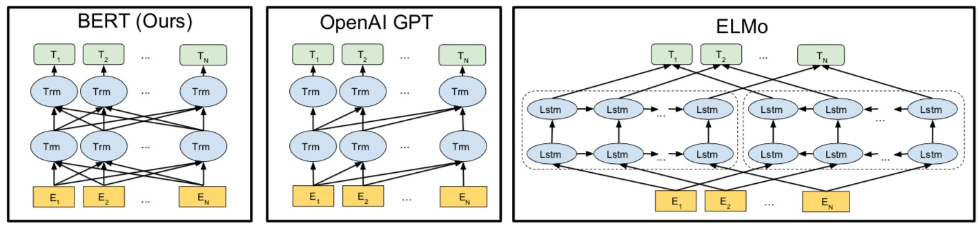
BERT, OpenAI GPT, ELMo
Source: Devlin, Jacob, Ming-Wei Chang, Kenton Lee, and Kristina Toutanova (2018).
"Bert: Pre-training of deep bidirectional transformers for language understanding." arXiv preprint arXiv:1810.04805.

Slide 69
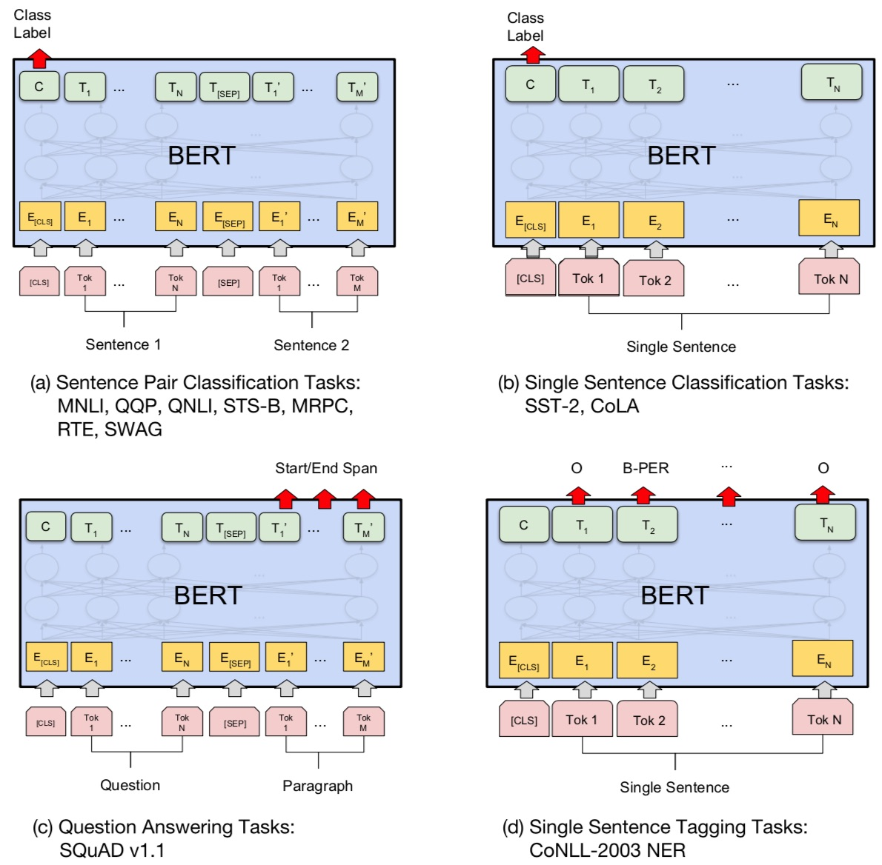
Fine-tuning BERT on Different Tasks
Source: Devlin, Jacob, Ming-Wei Chang, Kenton Lee, and Kristina Toutanova (2018).
"Bert: Pre-training of deep bidirectional transformers for language understanding." arXiv preprint arXiv:1810.04805.

Slide 70
Fine-tuning BERT on
Question Answering (QA)
Source: Devlin, Jacob, Ming-Wei Chang, Kenton Lee, and Kristina Toutanova (2018).
"Bert: Pre-training of deep bidirectional transformers for language understanding." arXiv preprint arXiv:1810.04805.

Slide 71
Fine-tuning BERT on Dialogue
Intent Detection (ID; Classification)
Source: Devlin, Jacob, Ming-Wei Chang, Kenton Lee, and Kristina Toutanova (2018).
"Bert: Pre-training of deep bidirectional transformers for language understanding." arXiv preprint arXiv:1810.04805.

Slide 72
Fine-tuning BERT on Dialogue
Slot Filling (SF)
Source: Devlin, Jacob, Ming-Wei Chang, Kenton Lee, and Kristina Toutanova (2018).
"Bert: Pre-training of deep bidirectional transformers for language understanding." arXiv preprint arXiv:1810.04805.

Slide 73
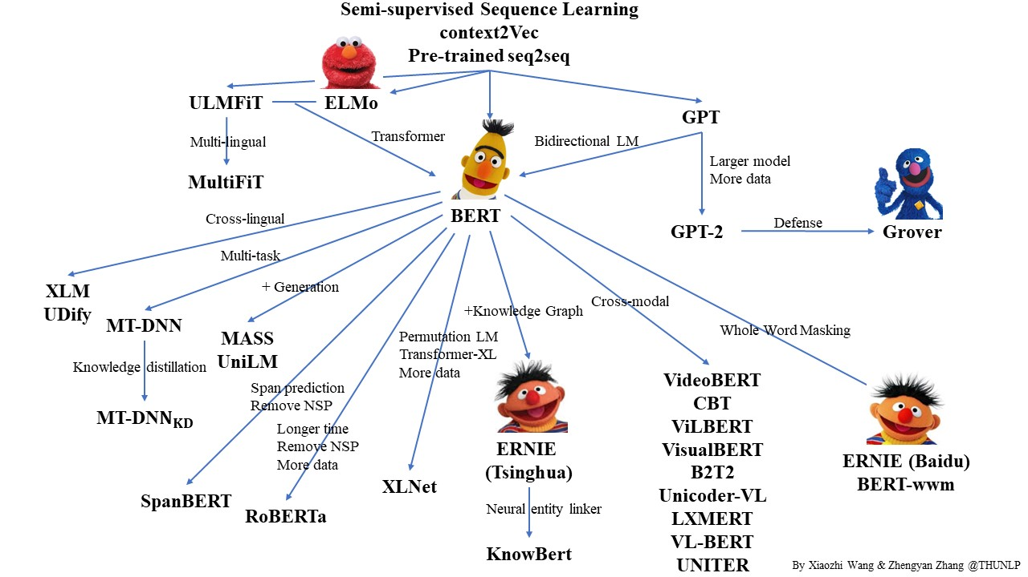
Pre-trained Language Model (PLM)
Source: https://github.com/thunlp/PLMpapers

Slide 74
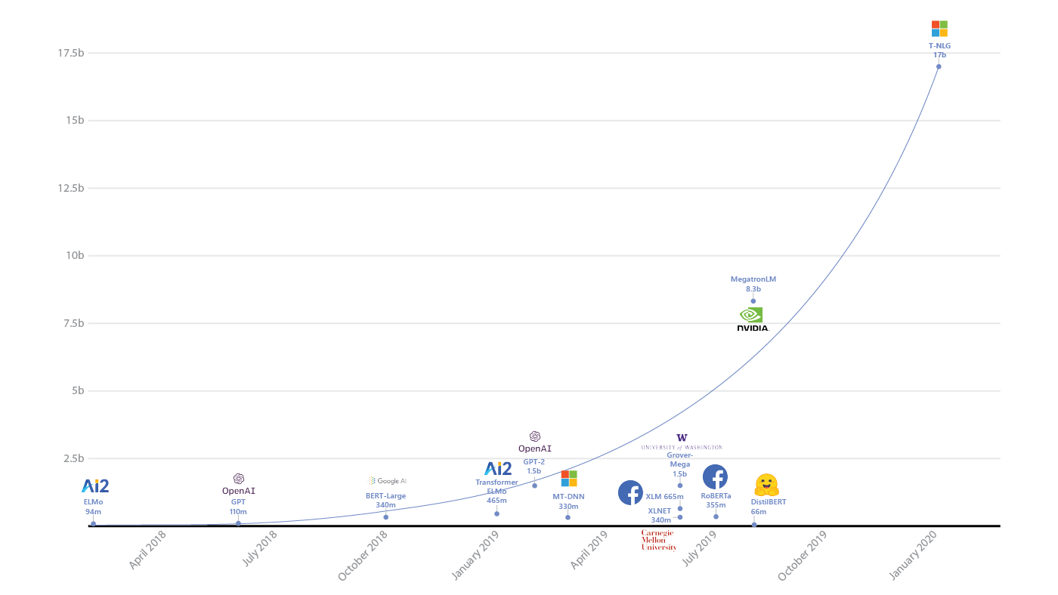
Turing Natural Language Generation (T-NLG)
T-NLG
17b
MegatronLM
8.3b
GPT-2
1.5b
BERT-Large
340m
RoBERTa
355m
DistilBERT
66m
2018
2019
2020
Source: https://www.microsoft.com/en-us/research/blog/turing-nlg-a-17-billion-parameter-language-model-by-microsoft/

Slide 75
Transformers
State-of-the-art Natural Language Processing for TensorFlow 2.0 and PyTorch
Transformers
  pytorch-transformers
  pytorch-pretrained-bert
provides state-of-the-art general-purpose architectures
  (BERT, GPT-2, RoBERTa, XLM, DistilBert, XLNet, CTRL...)
  for Natural Language Understanding (NLU) and
  Natural Language Generation (NLG)
  with over 32+ pretrained models
  in 100+ languages
  and deep interoperability between
  TensorFlow 2.0 and
  PyTorch.
Source: https://github.com/huggingface/transformers

Slide 76
Transfer Learning in Natural Language Processing
Source: Sebastian Ruder, Matthew E. Peters, Swabha Swayamdipta, and Thomas Wolf (2019), "Transfer learning in natural language processing." In Proceedings of the 2019 Conference of the North American Chapter of the Association for Computational Linguistics: Tutorials, pp. 15-18.

Slide 77
Question Answering
(QA)
SQuAD
Stanford Question Answering Dataset

Slide 78

SQuAD
https://rajpurkar.github.io/SQuAD-explorer/

Slide 79

SQuAD
Source: Rajpurkar, Pranav, Jian Zhang, Konstantin Lopyrev, and Percy Liang.
"Squad: 100,000+ questions for machine comprehension of text." arXiv preprint arXiv:1606.05250 (2016).

Slide 80

SQuAD (Question Answering)
Q: What causes precipitation to fall?
https://en.wikipedia.org/wiki/Precipitation

Slide 81
SQuAD (Question Answering)
Paragraph
In meteorology, precipitation is any product of the condensation of atmospheric water vapor that falls under gravity. The main forms of precipitation include drizzle, rain, sleet, snow, graupel and hail... Precipitation forms as smaller droplets coalesce via collision with other rain drops or ice crystals within a cloud. Short, intense periods of rain in scattered locations are called “showers”.
Q: What causes precipitation to fall?

Slide 82
SQuAD (Question Answering)
In meteorology, precipitation is any product of the condensation of atmospheric water vapor that falls under gravity. The main forms of precipitation include drizzle, rain, sleet, snow, graupel and hail... Precipitation forms as smaller droplets coalesce via collision with other rain drops or ice crystals within a cloud. Short, intense periods of rain in scattered locations are called “showers”.
Q: What causes precipitation to fall?
A: gravity

Slide 83
SQuAD (Question Answering)
In meteorology, precipitation is any product of the condensation of atmospheric water vapor that falls under gravity. The main forms of precipitation include drizzle, rain, sleet, snow, graupel and hail... Precipitation forms as smaller droplets coalesce via collision with other rain drops or ice crystals within a cloud. Short, intense periods of rain in scattered locations are called “showers”.
Q: What is another main form of precipitation besides drizzle, rain, snow, sleet and hail?
A: graupel

Slide 84
SQuAD (Question Answering)
In meteorology, precipitation is any product of the condensation of atmospheric water vapor that falls under gravity. The main forms of precipitation include drizzle, rain, sleet, snow, graupel and hail... Precipitation forms as smaller droplets coalesce via collision with other rain drops or ice crystals within a cloud. Short, intense periods of rain in scattered locations are called “showers”.
Q: Where do water droplets collide with ice crystals to form precipitation?
A: within a cloud

Slide 85
SQuAD (Question Answering)
In meteorology, precipitation is any product of the condensation of atmospheric water vapor that falls under gravity. The main forms of precipitation include drizzle, rain, sleet, snow, graupel and hail... Precipitation forms as smaller droplets coalesce via collision with other rain drops or ice crystals within a cloud. Short, intense periods of rain in scattered locations are called “showers”.
Q: What causes precipitation to fall?
A: gravity
Q: What is another main form of precipitation besides drizzle, rain, snow, sleet and hail?
A: graupel
Q: Where do water droplets collide with ice crystals to form precipitation?
A: within a cloud

Slide 86

SQuAD (Question Answering)
https://en.wikipedia.org/wiki/Super_Bowl_50

Slide 87
Dialogue on
Airline Travel Information System (ATIS)

Slide 88

The ATIS
(Airline Travel Information System)
Dataset
https://www.kaggle.com/siddhadev/atis-dataset-from-ms-cntk
Training samples: 4978
Testing samples: 893
Vocab size: 943
Slot count: 129
Intent count: 26
Source: Haihong, E., Peiqing Niu, Zhongfu Chen, and Meina Song. "A novel bi-directional interrelated model for joint intent detection and slot filling." In Proceedings of the 57th Annual Meeting of the Association for Computational Linguistics, pp. 5467-5471. 2019.

Slide 89

SF-ID Network (E et al., 2019)
Slot Filling (SF)
Intent Detection (ID)
A Novel Bi-directional Interrelated Model for Joint Intent Detection and Slot Filling
Source: Haihong, E., Peiqing Niu, Zhongfu Chen, and Meina Song. "A novel bi-directional interrelated model for joint intent detection and slot filling." In Proceedings of the 57th Annual Meeting of the Association for Computational Linguistics, pp. 5467-5471. 2019.

Slide 90

Intent Detection on ATIS
State-of-the-art
Source: https://paperswithcode.com/sota/intent-detection-on-atis

Slide 91

Slot Filling on ATIS
State-of-the-art
Source: https://paperswithcode.com/sota/slot-filling-on-atis

Slide 92
Restaurants Dialogue Datasets
MIT Restaurant Corpus
  https://groups.csail.mit.edu/sls/downloads/restaurant/
CamRest676
(Cambridge restaurant dialogue domain dataset)
  https://www.repository.cam.ac.uk/handle/1810/260970
DSTC2 (Dialog State Tracking Challenge 2 & 3)
  http://camdial.org/~mh521/dstc/

Slide 93

CrossWOZ:
A Large-Scale Chinese Cross-Domain Task-Oriented Dialogue Dataset
Source: Zhu, Qi, Kaili Huang, Zheng Zhang, Xiaoyan Zhu, and Minlie Huang. "Crosswoz: A large-scale chinese cross-domain task-oriented dialogue dataset." arXiv preprint arXiv:2002.11893 (2020).

Slide 94

CrossWOZ:
A Large-Scale Chinese Cross-Domain Task-Oriented Dialogue Dataset
Source: Zhu, Qi, Kaili Huang, Zheng Zhang, Xiaoyan Zhu, and Minlie Huang. "Crosswoz: A large-scale chinese cross-domain task-oriented dialogue dataset." arXiv preprint arXiv:2002.11893 (2020).

Slide 95


Task-Oriented Dialogue
Source: Zhu, Qi, Kaili Huang, Zheng Zhang, Xiaoyan Zhu, and Minlie Huang. "Crosswoz: A large-scale chinese cross-domain task-oriented dialogue dataset." arXiv preprint arXiv:2002.11893 (2020).

Slide 96
任務型對話系統
The Evaluation of Chinese Human-Computer Dialogue Technology, SMP2019-ECDT
自然語言理解
Natural Language Understanding (NLU)
對話管理
Dialog Management (DM)
自然語言生成
Natural Language Generation (NLG)
Source: http://conference.cipsc.org.cn/smp2019/evaluation.html
https://github.com/OnionWang/SMP2019-ECDT-NLU

Slide 97

Python in Google Colab (Python101)
https://colab.research.google.com/drive/1FEG6DnGvwfUbeo4zJ1zTunjMqf2RkCrT
Question Answering and
Dialogue Systems
https://tinyurl.com/aintpupython101

Slide 98
Summary
Artificial Intelligence
Question Answering
Dialogue Systems
Task Oriented Dialogue System

Slide 99
References
Stuart Russell and Peter Norvig (2020), Artificial Intelligence: A Modern Approach, 4th Edition, Pearson
Day, Min-Yuh and Chi-Sheng Hung, "AI Affective Conversational Robot with Hybrid Generative-based and Retrieval-based Dialogue Models", in Proceedings of The 20th IEEE International Conference on Information Reuse and Integration for Data Science (IEEE IRI 2019), Los Angeles, CA, USA, July 30 - August 1, 2019.
Day, Min-Yuh, Chi-Sheng Hung, Yi-Jun Xie, Jhih-Yi Chen, Yu-Ling Kuo and Jian-Ting Lin (2019), "IMTKU Emotional Dialogue System for Short Text Conversation at NTCIR-14 STC-3 (CECG) Task", The 14th NTCIR Conference on Evaluation of Information Access Technologies (NTCIR-14), Tokyo, Japan, June 10-13, 2019.
Zhou, Hao, Minlie Huang, Tianyang Zhang, Xiaoyan Zhu, and Bing Liu. "Emotional chatting machine: emotional conversation generation with internal and external memory." arXiv preprint arXiv:1704.01074 (2017).
Yu, Kai, Zijian Zhao, Xueyang Wu, Hongtao Lin, and Xuan Liu. "Rich Short Text Conversation Using Semantic Key Controlled Sequence Generation." IEEE/ACM Transactions on Audio, Speech, and Language Processing (2018).
Borah, Bhriguraj, Dhrubajyoti Pathak, Priyankoo Sarmah, Bidisha Som, and Sukumar Nandi. "Survey of Textbased Chatbot in Perspective of Recent Technologies." In International Conference on Computational Intelligence, Communications, and Business Analytics, pp. 84-96. Springer, Singapore, 2018.
Haihong, E., Peiqing Niu, Zhongfu Chen, and Meina Song. "A novel bi-directional interrelated model for joint intent detection and slot filling." In Proceedings of the 57th Annual Meeting of the Association for Computational Linguistics, pp. 5467-5471. 2019.
Rajpurkar, Pranav, Jian Zhang, Konstantin Lopyrev, and Percy Liang. "Squad: 100,000+ questions for machine comprehension of text." arXiv preprint arXiv:1606.05250 (2016).
Zhu, Qi, Kaili Huang, Zheng Zhang, Xiaoyan Zhu, and Minlie Huang. "Crosswoz: A large-scale chinese cross-domain task-oriented dialogue dataset." arXiv preprint arXiv:2002.11893 (2020).
Zeng, Zhaohao, Sosuke Kato, Tetsuya Sakai, and Inho Kang (2020), “Overview of the NTCIR-15 Dialogue Evaluation (DialEval-1) Task”, Proceedings of NTCIR-15, 2020.
Apoorv Nandan (2020), BERT (from HuggingFace Transformers) for Text Extraction, https://keras.io/examples/nlp/text_extraction_with_bert/
Olivier Grisel (2020), Transformers (BERT fine-tuning): Joint Intent Classification and Slot Filling, https://m2dsupsdlclass.github.io/lectures-labs/
Dipanjan Sarkar (2019), Text Analytics with Python: A Practitioner’s Guide to Natural Language Processing, Second Edition. APress. https://github.com/Apress/text-analytics-w-python-2e
Benjamin Bengfort, Rebecca Bilbro, and Tony Ojeda (2018), Applied Text Analysis with Python, O'Reilly Media.
https://www.oreilly.com/library/view/applied-text-analysis/9781491963036/
HuggingFace (2020), Transformers Notebook, https://huggingface.co/transformers/notebooks.html
The Super Duper NLP Repo, https://notebooks.quantumstat.com/
Min-Yuh Day (2020), Python 101, https://tinyurl.com/aintpupython101

Slide 100
Q & A
人工智慧任務導向對話系統
(AI Task-Oriented Dialogue System)
中國文化大學應用數學系專題演講
Host: Prof. Chia-Hui Liu
Department of Applied Mathematics, Chinese Culture University
Time: 13:10-15:00, Nov 27, 2020 (Friday)
Place: 理學院會議室 (大義館610), CCU
Address: 55, Hwa-Kang Rd., Yang-Ming-Shan, Taipei, Taiwan
Min-Yuh Day
戴敏育
Associate Professor
副教授
Institute of Information Management, National Taipei University
國立臺北大學 資訊管理研究所
https://web.ntpu.edu.tw/~myday
2020-11-27

